Slide 1
Site Collaboration: Math Talks
Notes:
Welcome - Dianne

Slide 2
What are Math Talks?
What do you notice or wonder?
Which one doesn’t belong?
Dot Talks
Where did we start?
Number Talks
Would you rather?
Notes:
Doug
Strategy for engagement, curiosity, flexibility, student discourse, making student thinking visible
Zero in on WODB and Number Talks for demos

Slide 3
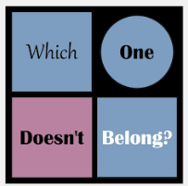
www.WODB.ca
Notes:
Doug

Slide 4
Which one Doesn’t Belong?
8 | 4
3 | 2
Notes:
Doug
With teachers: use 4 corners
With students: use SMOYF

Slide 5
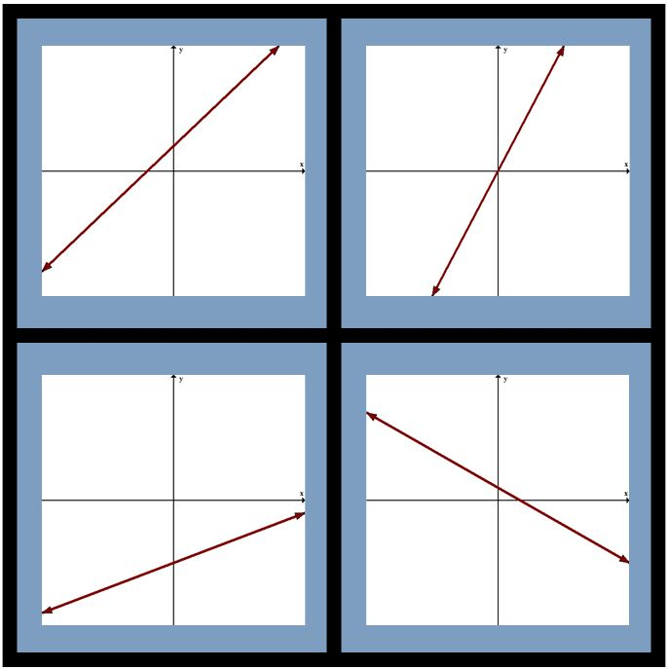
Which one Doesn’t Belong?
2
1
3
4
Notes:
Deb
When might you use this type of math talk?

Slide 6
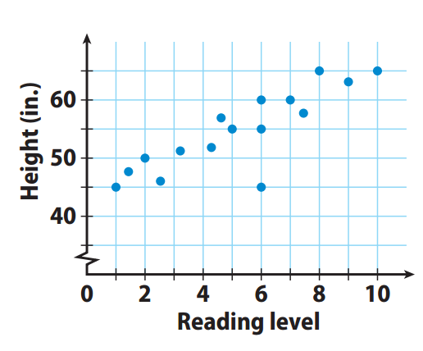
What do you notice or wonder?
Notes:
Deb
Scatter plots, association, outliers, graph break
5 min
Thumbs up – think time and then share whole class.
What if someone makes a prediction that is wrong?
When might you use this type of math talk?

Slide 7
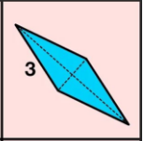
Tell me what you know.
Notes:
Deb
5 min
Thumbs up – think time and then share whole class.
What if someone makes a prediction that is wrong?
When might you use this type of math talk?

Slide 8
Where did we start?
Joe simplified an expression and got a result of 4x². What was the original problem?
Notes:
Deb
5 min
When might you use this kind of math talk?
I’ve seen teachers do this as a whip around – no recording

Slide 9
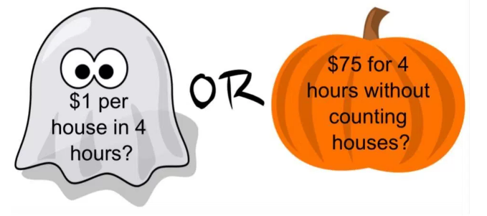
Would you rather…?
Would you rather be paid with Option A or Option B for taking your sibling trick-or-treating?
Option A
Option B
Notes:
Deb

Slide 10
Then…What are Number Talks?
Number sense
Place Value
Fluency
Properties
Notes:
Kathy

Slide 11
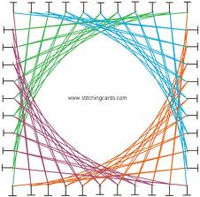
Design of Number Talks: Strings
Designed to build mental facility with a computational strategy and concept.
Starts with small numbers to emphasize strategy and build confidence.
Consists of a series of 3-5 related computational problems.
Notes:
Kathy

Slide 12
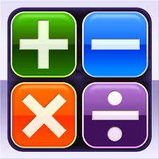
Focus Areas
Addition
Subtraction
Multiplication
Division
Fractions, Decimals, Percent
Integers
Exponents
Proportional Reasoning
Notes:
Kathy

Slide 13
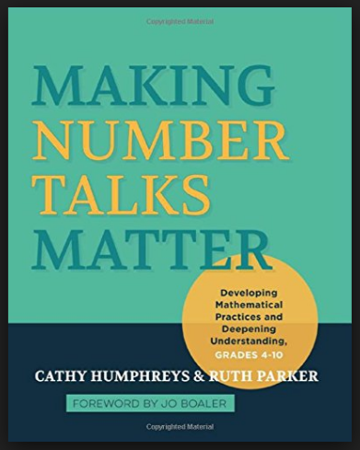
Strategies
Friendly/Landmark Numbers
Doubles/Near Doubles
Breaking numbers into place value
Adding Up
Adjusting One Number
Partial Products
Doubling/Halving
Partial Quotients
Decomposition
Compensation
Notes:
Kathy

Slide 14
Number Talk Classroom Procedures
Gather at the board or in seats
Solve problem mentally
Show you are thinking by putting fist to chest
Put thumb up when you know answer
Put two fingers up if you have more than one way to solve the problem
Partner talk (consideration)
Field responses---just the answer
Call on students to explain their thinking
Script answers
Notes:
Kathy
Physical consideration: keeping each problem and responses on board
Consideration: scribing the strategies used

Slide 15
Number Talks
What is 50% of 140?
What is 10% of 140?
What is 5% of 140?
What is 35% of 140?
What is 17.5% of 140?
Notes:
Kathy, Deb

Slide 16
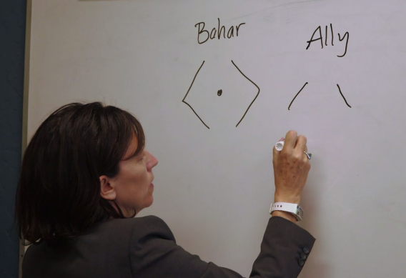
Dot Talks
Notes:
Deb
Note: She modifies the number talk method a bit here—we’ll have you discuss why you think she may have done it a bit differently.
At the beginning of this presentation, you saw Ruth say that dot talks worked with high school students. In the book, the authors say that all math talks should start with dot talks. I watched a Jo Boaler video https://www.youcubed.org/jo-dot-card-number-talk/
and didn’t think these would work for secondary students….. My experience….. See next slide

Slide 17
Things to Remember
Encourage students to try someone else’s method on subsequent problems in a string.
Watch for opportunities to move students toward your purpose for the day.
Encourage students to use what they know, by planning a sequence of problems that are useful to each other.
Avoid turning a Math Talk into a mini lesson.
Notes:
Kathy

