Slide 1
Number Talks

Slide 2
What is a Number Talk?
Short, ongoing routine that provides students with meaningful practice with computation.
Primary goal is computational fluency.

Slide 3
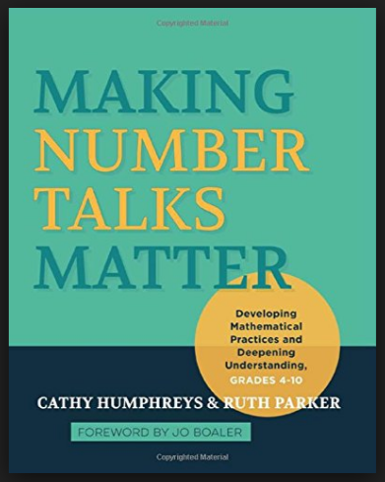
Resources
Notes:
If books are missing, follow up with previous PLC leader

Slide 4
Design
A number talk is a classroom conversation around purposefully crafted computation problems that are solved mentally.
Problems in a number talk are designed to elicit specific strategies that focus on number relationships and number theory.

Slide 5
Design of Number Talks: Strings
Designed to build mental facility with a computational strategy and concept.
Starts with small numbers to emphasize strategy and build confidence.
Consists of a series of 3-5 related computational problems.

Slide 6
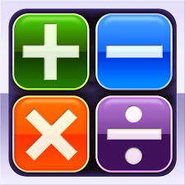
Focus Areas
Addition
Subtraction
Multiplication
Division

Slide 7
Strategies
Friendly/Landmark Numbers
Doubles/Near Doubles
Breaking numbers into place value
Adding Up
Adjusting One Number
Landmark/Friendly
Compensation
Partial Products
Doubling/Halving
Partial Quotients

Slide 8
Compensation:
19 + 6
9 + 16
9 + 26
29 + 6
20 + 5
10 + 15
10 + 25
30 + 5

Slide 9
Doubling and Halving:
5 X 32
15 X 8
16 X 35
10 X 16
30 X 4
8 X 70

Slide 10
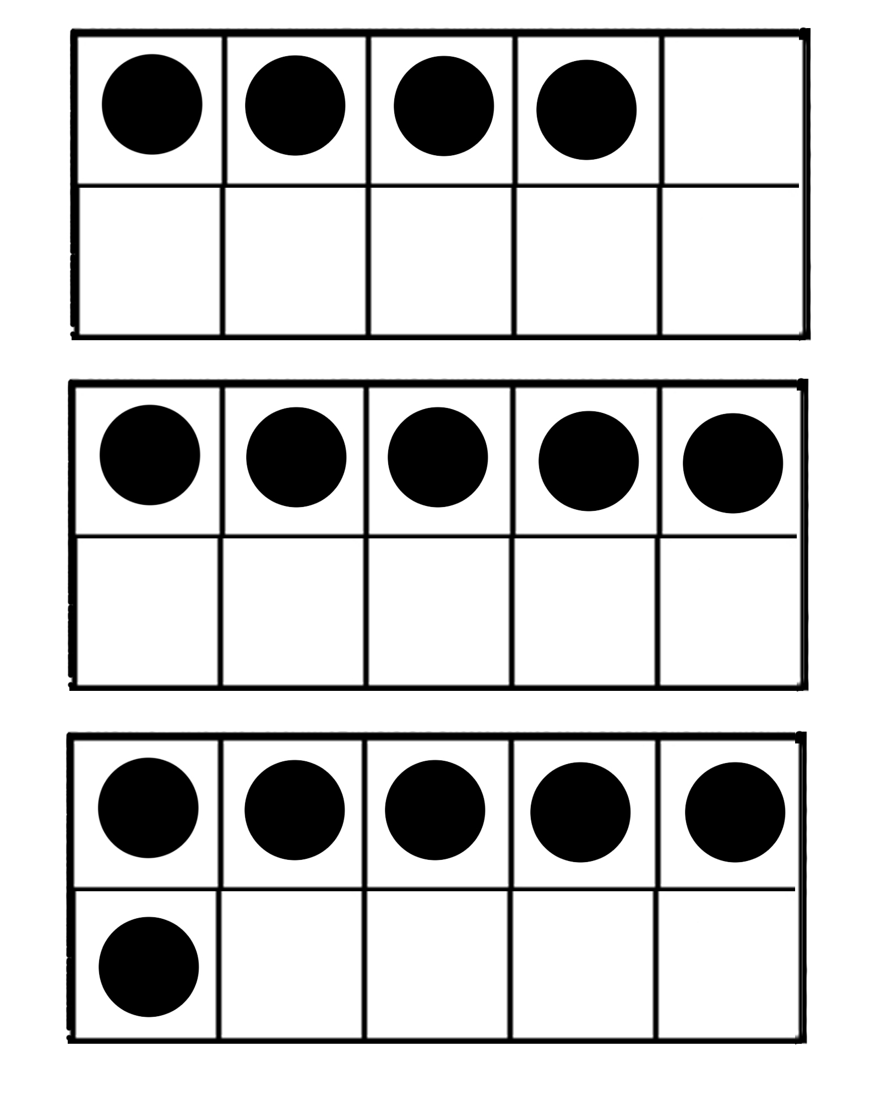
Kinder/1st Grade

Slide 11
Number Talk Classroom Procedures
Gather at the board/carpet or in seats
Solve problem mentally
Show you are thinking by putting fist to chest
Put thumb up when you know answer
Put two fingers up if you have more than one way to solve the problem
Field responses---just the answer
Call on students to explain their thinking
Script answers
Notes:
During script:
Script as closely to what students say as close as possible
Leave wrong answer up there…leave it hanging
Address algorithm quickly and move on
As become more proficient consider creating a chart of the strategies used (validate strategies that surface)
Strategies come out of the Number Talk, the Number Talk is not driven by posing strategies first

Slide 12
Voice From the Field
Click on the image to view the video

Slide 13
Things to Remember
Encourage students to try someone else’s method on subsequent problems in a string.
Watch for opportunities to move students toward your purpose for the day.
Encourage students to use what they know, by planning a sequence of problems that are useful to each other.
Avoid turning a Number Talk into a mini lesson.

