Slide 1
Algebra Tiles
Using Algebra tiles to support students conceptual understanding

Slide 2
Algebra Tile Overview
Conceptual Understanding through Manipulatives in K-5
Conceptual Understanding through Manipulatives in Middle Grades
Making “zero” Pairs
Model a word expression
Build strong math vocabulary
Distributive property
Apply properties to make equivalent expressions
Solve one-variable equations and inequalities
Conceptual Understanding of Writing Algebraic Expressions and Equations

Slide 3
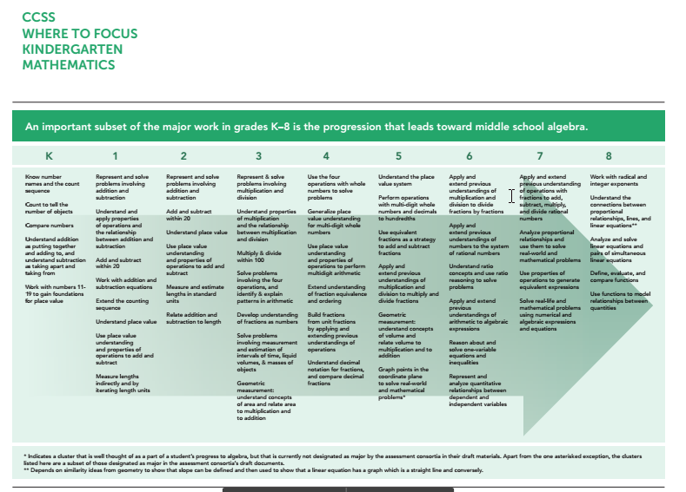
Achievethecore.org
K-8 Progression

Slide 4
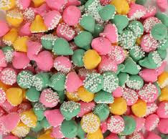
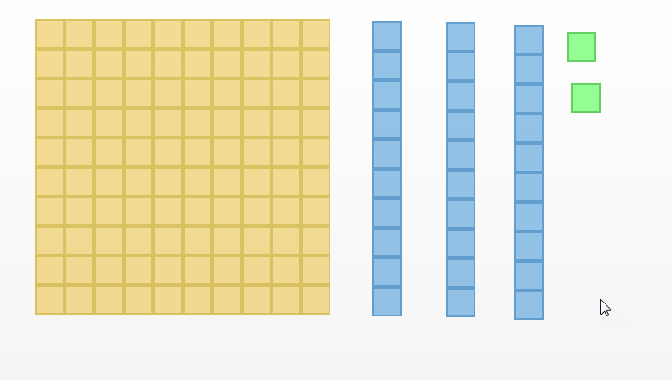
Base Ten Blocks K-4
One one hundred
Three tens
Two ones
132
100+30+2

Slide 5
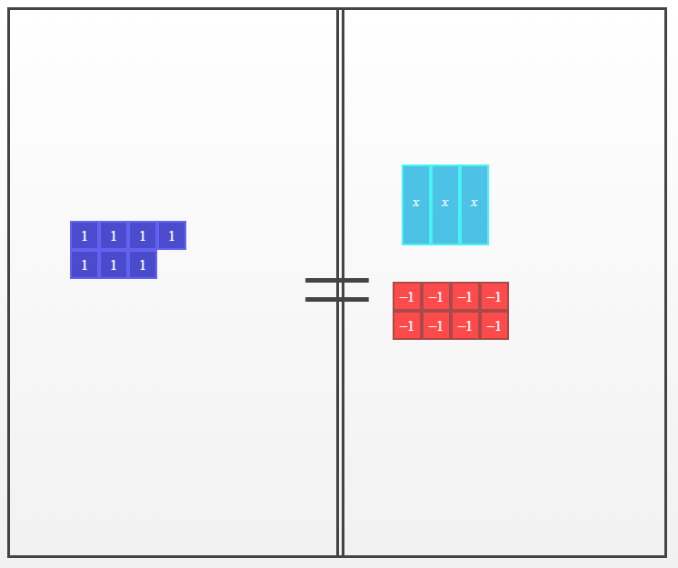
Activate and Connect
7 = 3x - 8

Slide 6
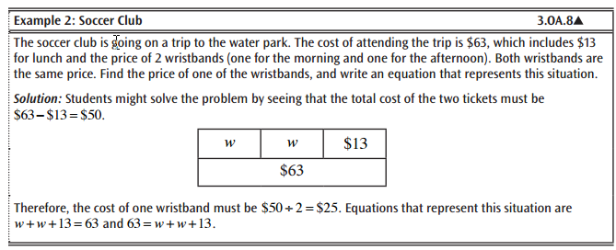
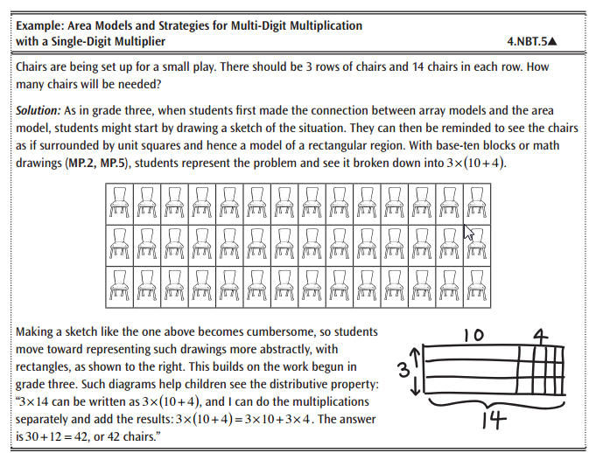
Connecting Concepts
Math Framework Grade 4
Multiplication Arrays
Math Framework Grade 3
Tape Diagram/ Comparison Mat

Slide 7
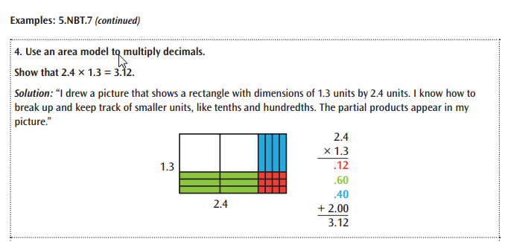
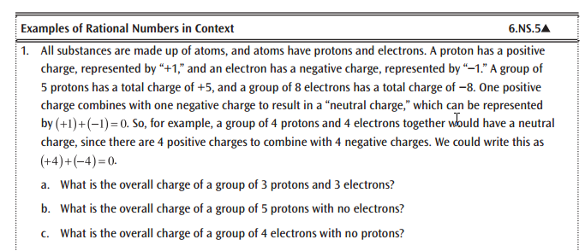
Connecting Concepts
Math Framework Grade 5
Decimal Multiplication Arrays
Math Framework Grade 6
Examine Rational Numbers and their Opposites

Slide 8
Framework at a Glance
Grade six marks a foundational year for building the bridge between concrete concepts of arithmetic and the abstract thinking of algebra. Visual representations and concrete models (such as algebra tiles, counters, and cubes) can help students develop understanding as they move toward using abstract symbolic representations.
Privately Read Middle Grades at a Glance Handout.
What do you notice about the progression of ideas?
What strikes you?
Form a Triad:
Share Out

Slide 9
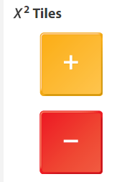
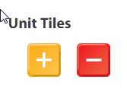
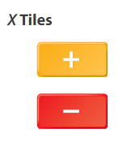
Algebra Tiles

Slide 10
Solidify the “Zero Pair” with Tiles
1
(-1) = 0
3
(-3) = 0

Slide 11
Grade 6 Standard

Slide 12
Algebraic Mats
Expression Mats
Equation Mats
http://bit.ly/algebratilemats

Slide 13
Integers - Use of Expression Mat
Uses might include:
Making “zero” Pairs (G6M3,G7M1)
Model a word expression
Build strong math vocabulary
Integer addition and subtraction (G7M1)
Integer Multiply and Divide
Distributive property
Apply properties to make equivalent expressions
Solve one-variable equations and inequalities
What is 5 + 4
What is 6 - 3 (zero pair)
Write a zero pair number sentence
What is -2 + 5
What is (-5) + (-4)
What is -6 - (-2)
What number sentence describes the model?

Slide 14
Use of Expression Mat
What number sentence describes the model?
Uses might include:
Making “zero” Pairs
Model a word expression(G6M7, G7M6,G8M7)
Build strong math vocabulary (G6M7)
Integer addition and subtraction
Integer Multiply and Divide
Distributive property (G6M7,G7M6, G8M7)
Apply properties to make equivalent expressions
Solve one-variable equations and inequalities
Model Six times a number less three
Build 2x - 3y + 5 on your mat.
-Identify the operation
-Identify the number of terms
-Identify the variables, their coefficients
-Identify the constant
Build (x+3), build another (x+3)
Build the expression 7x - 21 in 2 ways

Slide 15
Use of Expression Mat
Uses might include:
Making “zero” Pairs
Model a word expression
Build strong math vocabulary
Integer addition and subtraction
Integer Multiply and Divide (G7M2)
Distributive property (G6M7,G7M6, G8M7)
Apply properties to make equivalent expressions (G6M7,G7M6, G8M7)
Solve one-variable equations and inequalities
What is (-3)(-4): the opposite of 3 sets of -4
Build an expression 7x - 3
Simplify (3x+1) + (2x-7)
Simplify 5 + 3(x + 1) - 7x
What number sentence describes the model?

Slide 16
Use of Comparison Mat
Uses might include:
Making “zero” Pairs
Model a word expression
Build strong math vocabulary
Integer addition and subtraction
Integer Multiply and Divide
Distributive property
Apply properties to make equivalent expressions (G6M7,G7M6, G8M7)
Solve one-variable equations and inequalities (G6M8, G7M6&7, G8M7)
Find an equivalent expression to 2(2x-4)+3
Write an equivalent expression for
(3x + 1) + (2x -7)
Which is greater? 2x+8-x-3 or 6+x+1
Model the inequality and find 3 possible solutions for 6x - 4 > 8

Slide 17
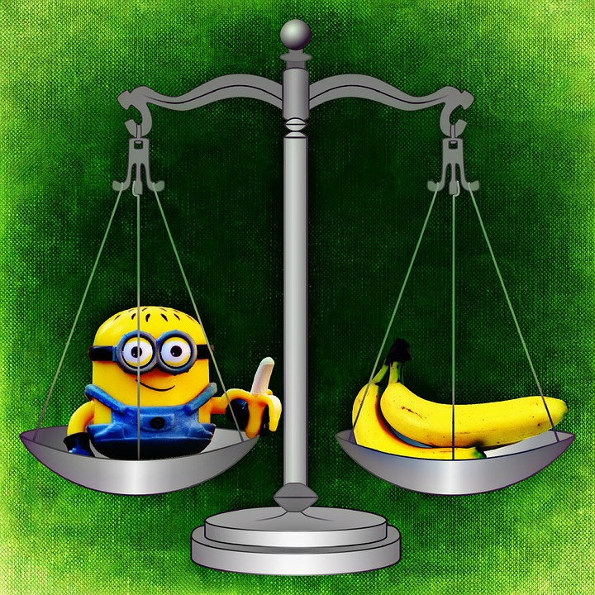
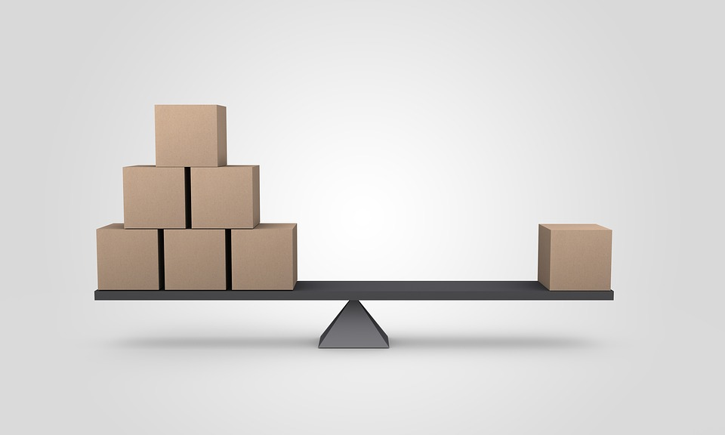
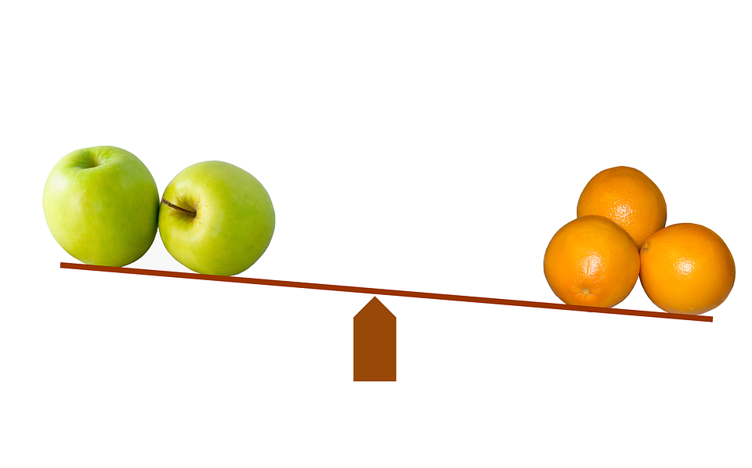
Use of Equation Mat

Slide 18
Use of Equation Mat A
Uses might include:
Making “zero” Pairs
Model a word expression
Build strong math vocabulary
Integer addition and subtraction
Integer Multiply and Divide
Distributive property
Apply properties to make equivalent expressions
Solve one-variable equations and inequalities (G6M8, G7M6&7, G8M7)
Solve 3x - 2 = 7
Solve 2x + 4 = 5
Solve 2x + 10 = 38
Solve -3x + 4 = 5
Solve 2x + 10 = 38
Solve x + 5 = 3x - 1
Solve x + 4 = -x - 4
What number sentence describes the model?

Slide 19
Integers - Use of Equation Mat B
Uses might include:
More deeply explore multiple terms and operations on each side of an equations
Solve 3(x - 5) + 1 = 2 + x
Solve 3x -2(5x + 3) = 14 - 2x
What number sentence describes the model?

Slide 20
What if...
The equation isn’t written yet?
Concrete
Representational
Abstract

Slide 21
Progression before Middle Grades

Slide 22
Progression before Middle Grades

Slide 23
Progression before Middle Grades

Slide 24
Progression before Middle Grades
3 + 2 = 5

Slide 25
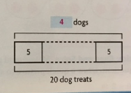
Progression before Middle Grades
Go Math Grade 3

Slide 26
Progression before Middle Grades
Go Math Grade 4

Slide 27
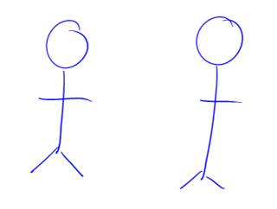
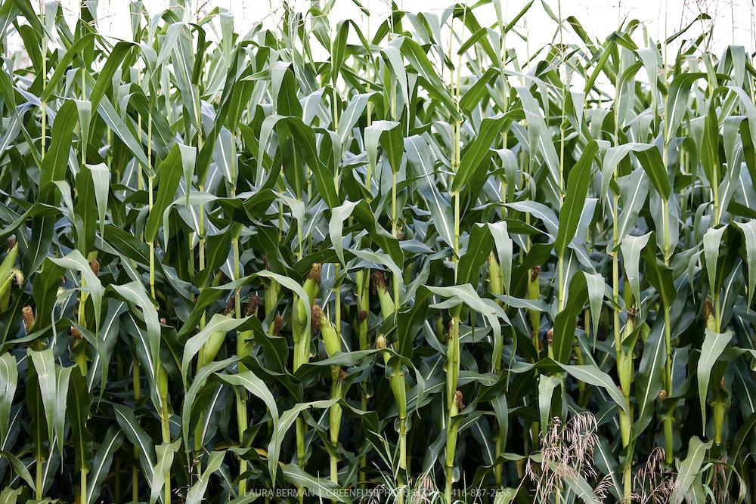
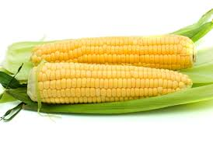
Progression before Middle Grades
Go Math
Lorkich picked 3 times as much corn as Ethup.

Slide 28
Progression before Middle Grades
Go Math
Lorkich picked 3 times as much corn as Ethup.
Together, they pick 96 ears of corn.

Slide 29
Progression before Middle Grades
Go Math
Lorkich picked 3 times as much corn as Ethup.
Together, they pick 96 ears of corn.
Ethup wants to divide the number of ears she picked equally among 8 bags. How many ears of corn will Ethup put into each of the 8 bags?

Slide 30
Sample Task from SBAC Grade 6
A recipe requires ½ cup of flour for every batch of cookies. How many full batches of cookies can be made with 5 ½ cups of flour?

Slide 31
Sample Task
Allan puts some brown sugar on a dish. The total weight of the brown sugar and the dish 110 ounces. Bella puts three times the amount of brown sugar as Allan did, on an identical dish. The total weight of Bella’s brown sugar and the dish is 290 ounces.
Find the weight of the brown sugar that Bella puts on the dish.

Slide 32
Sample Task
Allan puts some brown sugar on a dish. The total weight of the brown sugar and the dish 110 ounces. Bella puts three times the amount of brown sugar as Allan did, on an identical dish. The total weight of Bella’s brown sugar and the dish is 290 ounces.
Find the weight of the brown sugar that Bella puts on the dish.

Slide 33
Partner Time: developing equations from bar models
Using a Diagram Related Equations

Slide 34
Partner Time: developing equations from bar models
Using a Diagram Related Equations
What questions could be asked to get kids started?
What questions could be asked about the bar diagram that help students make connections to the context?

Slide 35
Notice... and Wonder...
Taira and Meredith each had the same amount of money. Taira spent $58 to fill the car up with gas for a road-trip. Meredith spent $37 buying snacks for the trip.

Slide 36
Notice... and Wonder...
Taira and Meredith each had the same amount of money. Taira spent $58 to fill the car up with gas for a road-trip. Meredith spent $37 buying snacks for the trip.
Afterward, the ratio of Taira’s money to Meredith’s money is 1:4 .

Slide 37
What Math Questions could be asked?
Taira and Meredith each had the same amount of money. Taira spent $58 to fill the car up with gas for a road-trip. Meredith spent $37 buying snacks for the trip.
Afterward, the ratio of Taira’s money to Meredith’s money is 1:4 .

Slide 38
What Math Questions could be asked?
Taira and Meredith each had the same amount of money. Taira spent $58 to fill the car up with gas for a road-trip. Meredith spent $37 buying snacks for the trip.
Afterward, the ratio of Taira’s money to Meredith’s money is 1:4 .
Question for us: How much money did each have at first?

Slide 39
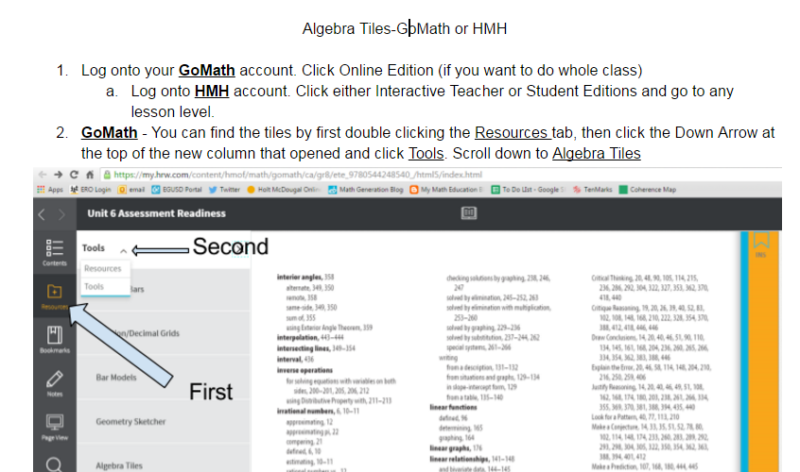
HMH Online Algebra Tiles

Slide 40
Questions?
Advantages?
Challenges?
Where can you see these ideas being used in your classroom?

