Slide 2
What is WATCH D.O.G.S.?
Father involvement program
    National Center For Fathering, Kansas City, MO
    Began 1998 in Arkansas
    Offered in over 2,600 school in 42 states
    Offered in over half of EGUSD Elementary Schools

Slide 3
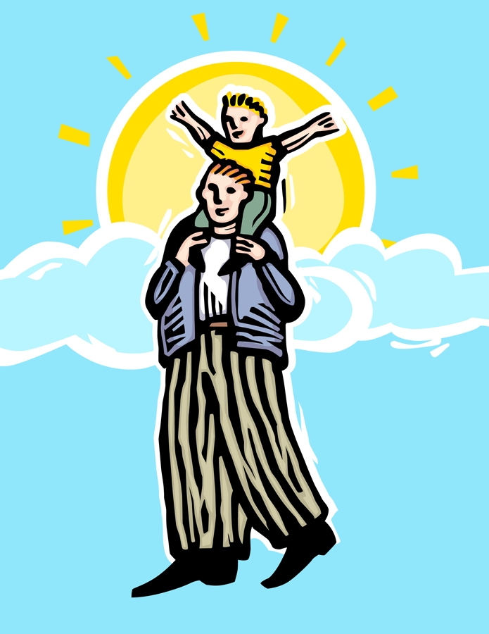
Program goals
To provide positive male role models
To provide help with campus safety

Slide 4
Why watch d.o.g.s. ?
Endorsed by the President’s Advisory Council
Support schools in helping students develop socially, physically, academically, and emotionally
Give Dads and father-figures an opportunity to volunteer
Promote the importance of education

Slide 5
How will the program work?
You will volunteer to come in for 1 one full day at school.
You will work in your child’s classroom
You will help our staff during the morning duty before school (7:45-8:15 AM)
You will be visible during recess and lunch
You will help our staff at the end of the day during dismissal (assisting traffic flow)

Slide 6
A Typical Watch d.o.g.s. Day
Starts at 7:45AM: check-in at front office, have child/dad picture taken
8:00-8:15 Assist with morning duty
8:15-9:00 Work in child’s classroom
9:00-10:00 Volunteer in another classroom
10:05-11:05 Be visible on playground during recesses
11:05-1:20 Assist with lunch (eat lunch with students)
1:20-2:30 Volunteer in another classroom
2:35 Assist with dismissal duties

Slide 7
Derek Redmond Story
Olympics 1992
400-meter race
Injured Achilles tendon
5 surgeries
During the race, injured hamstring
Hobbled toward finish line
Dad assisted him across the finish line

Slide 8
Watch D.o.G.s. Prepare Students to persevere
Finish Line!

Slide 9
Everyone wins with
Watch d.o.g.s
Students
School
Dads/father-figures
Community

Slide 10
Next Steps
Look at your calendars for October, November, and December
Find one day that you can volunteer at school as a Stone Lake WATCH D.O.G.
Put your name/child’s name/teacher name on the calendar to show your commitment
Pick up a reminder card for your fridge and place your committed date on it
Order a t-shirt to wear on your appointed day
Show up!

Slide 11
Questions????

Slide 12
Let’s Eat!
Enjoy the Spaghetti Dinner provided this evening by The Pride of Laguna Lions Club

Slide 13
Don’t forget to sign up!
Sign up at the side table
Take a reminder card for your fridge
Order your t-shirt
Tell others about the WATCH D.O.G.S Program

