Slide 1


Summer Institute
2017

Slide 2
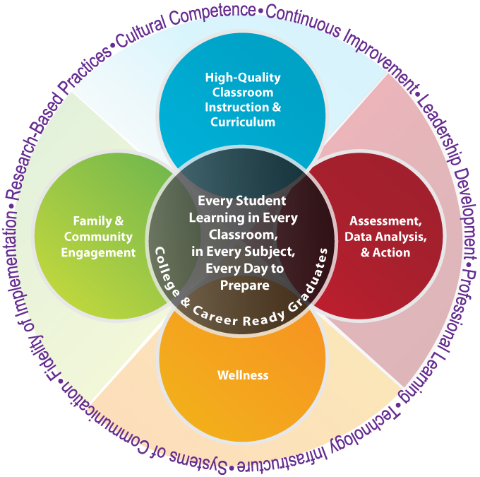

E4—Where do we fit?
Notes:
This is our E4, which is our overall District vision… EGUSD is a learning organization made up of interconnected processes and practices linked to the classroom, school, district, and community. E4 represents the District’s comprehensive and cohesive integrated learning system. It is inclusive of key stakeholders, is systematic in design, implementation, and evaluation, and supports our goal of ensuring that every child is adequately prepared for post-secondary education, life-long learning, successful employment, and responsible citizenship.
Wellness – Healthy bodies and healthy minds contribute to academic performance, attendance and positive behavior.
Our tagline is: Healthy Bodies, Healthy Minds and Healthy learning.

Slide 3
Model of Skill Relationships
Student Response to Instruction and Classroom Environment
Teaching and Learning Progression
Classroom
Instruction
Academic Enablers
Academic Proficiency/
Mastery
Academic Skills
Interpersonal
Engagement
Motivation
Study Skills
Understanding the essential link between the Common Core State Standards and direct behavioral instruction.
Adapted from Diperna & Elliott, 2000; Elliott, DiPerna & Shapiro, 2001
Notes:
In order for the students to achieve academic proficiency/mastery, the students must begin with classroom instruction, but must also have the ability to work on the enablers to be able to achieve the academic skills and move towards master
Background and Talking Points for Model of Skill Relationships Slide
Cognitive Research suggests:
Every academic skill also has an academic behavior(s) necessary to learn and/or perform that skill.
Poorly developed or performed intra- and/ or inter-personal behavior can interfere with the acquisition or performance of an academic skill.
Emphasis on collaborative engagement among students requires social and interpersonal skills.
Components of effective instruction are similar whether academic or behavioral focus
Academic Skills
Goal setting tied to state/district standards
Common Core State Standards
Developmental Standards
Academic Behaviors-Student Engagement
Behaviors associated with successful completion of the academic skills
On-task, listening, following-directions, ignoring distractions, self-monitoring, goal setting, content or private speech
Inter-/Intra-Personal Behaviors
Behaviors that support social skills
Social/emotional development
One model of Skill Relationships:
Academic Competence:
– Multidimensional construct composed of skills, attitudes and behaviors of a learner that contribute to academic success in the classroom
• Academic Skills:
– Basic and complex skills that are a central part of academic curricula in schools.
• Academic Enablers go beyond academic focus
These enablers help students access the content for learning:
Interpersonal, Engagement, Motivation and Study Skills

Slide 4
Training Expectations
Be Safe
Watch for power cords
Keep belongings tidy to prevent trips
Be Respectful
Disconnect to connect
Listen during presentation time
Be Engaged
Participate fully with your team
Use team time to complete tasks
Share ideas for support
Question to clarify
Listen to learn
Notes:
Review the expectations and highlight how we use our expectations just like they use at their meetings and in their classrooms.

Slide 5

Agenda for today…
Sharing Our Accomplishments
Trauma Informed Care
Classroom Management
Bully Prevention
Pre-service & Kickoff Planning
Finalize Action Plan
Team time! ☺

Slide 6

Share Out
Think about this past school year…
What are two of your greatest accomplishments from this year?
What is one of your biggest challenges?
How are you hoping to address the challenge?

Slide 7


Trauma Informed Care

Slide 8
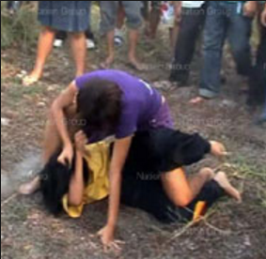




Students have complex needs…
Notes:
We have many students in our schools that are carrying a heavy burden that we may know nothing about. Their behavior may or may not present as problem behavior, depending upon how they deal with what’s going on inside.

Slide 9
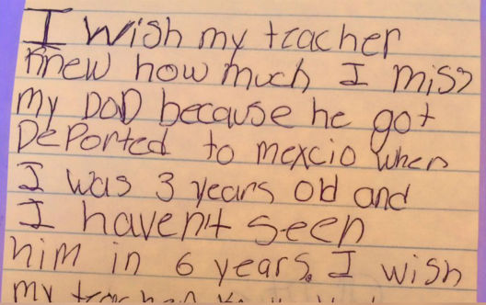
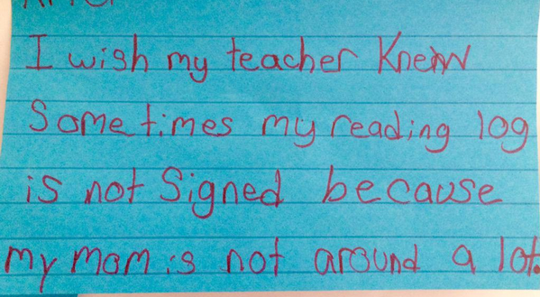
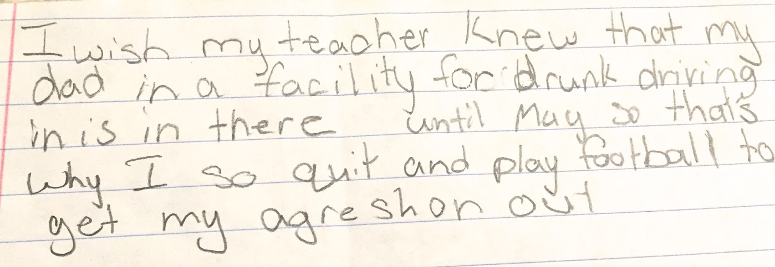
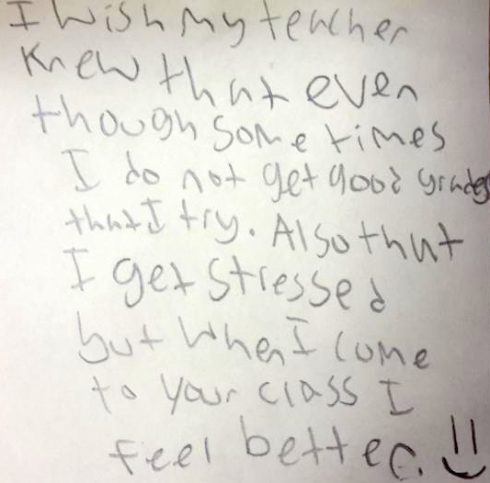
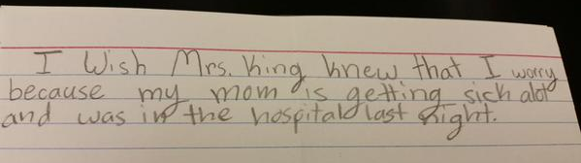
“I Wish My Teacher Knew”…
Notes:
This is a simple activity that can give us insight into the students’ lives that we serve.

Slide 10


Empathy
Notes:
Show this video and then give time for teams to discuss if empathy at their school. Is it something that can be improved among students/ staff? Is it already a strength at their site? The video is about 4 minutes

Slide 11
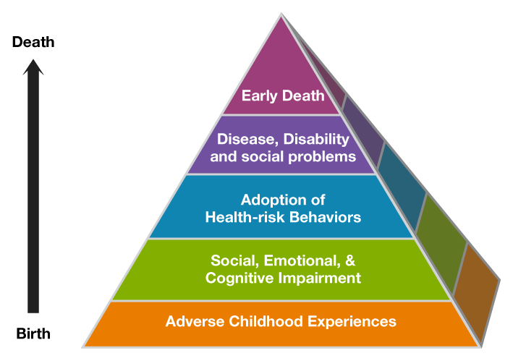
Adverse Childhood Experiences
Notes:
The ACE Pyramid represents the conceptual framework for the ACE Study. The ACE Study has uncovered how ACEs are strongly related to development of risk factors for disease, and well-being throughout the life course.
When one experiences trauma, there usually is social, emotional and cognitive impairment, potential to adopt health-risk behaviors, disease, disabilities and social problems and eventually early death.

Slide 12

ACES Study
The ACES study--
Center for Disease Control & Kaiser Hospital
17,000 Patients participated between 1995 and 1997
Measured 10 childhood traumas –
  Abuse: emotional, physical and sexual abuse
  Household: mother treated violently, substance abuse in household, mental illness, parental separation/divorce, criminal household member
  Neglect: Emotional and physical
Notes:
The CDC-Kaiser Permanente Adverse Childhood Experiences (ACE) Study is one of the largest investigations of childhood abuse and neglect and later-life health and well-being.
The original ACE Study was conducted at Kaiser Permanente from 1995 to 1997 with two waves of data collection. Over 17,000 Health Maintenance Organization members from Southern California receiving physical exams completed confidential surveys regarding their childhood experiences and current health status and behaviors.
The CDC continues ongoing surveillance of ACEs by assessing the medical status of the study participants via periodic updates of morbidity and mortality data.
All ACE questions refer to the respondent’s first 18 years of life.
Abuse
Emotional abuse: A parent, stepparent, or adult living in your home swore at you, insulted you, put you down, or acted in a way that made you afraid that you might be physically hurt.
Physical abuse: A parent, stepparent, or adult living in your home pushed, grabbed, slapped, threw something at you, or hit you so hard that you had marks or were injured.
Sexual abuse: An adult, relative, family friend, or stranger who was at least 5 years older than you ever touched or fondled your body in a sexual way, made you touch his/her body in a sexual way, attempted to have any type of sexual intercourse with you.
Household Challenges
Mother treated violently: Your mother or stepmother was pushed, grabbed, slapped, had something thrown at her, kicked, bitten, hit with a fist, hit with something hard, repeatedly hit for over at least a few minutes, or ever threatened or hurt by a knife or gun by your father (or stepfather) or mother’s boyfriend.
Household substance abuse: A household member was a problem drinker or alcoholic or a household member used street drugs.
Mental illness in household: A household member was depressed or mentally ill or a household member attempted suicide.
Parental separation or divorce: Your parents were ever separated or divorced.
Criminal household member: A household member went to prison.
Neglect¹
Emotional neglect: Someone in your family helped you feel important or special, you felt loved, people in your family looked out for each other and felt close to each other, and your family was a source of strength and support.²
Physical neglect: There was someone to take care of you, protect you, and take you to the doctor if you needed it², you didn’t have enough to eat, your parents were too drunk or too high to take care of you, and you had to wear dirty clothes.
¹Collected during Wave 2 only.
² Items were reverse-scored to reflect the framing of the question.

Slide 13

ACES Study Findings…
The findings show that :
ACES’s are more common than recognized or acknowledged
Almost two-thirds of study participants reported at least one ACE, and more than one in five reported three or more ACEs.
The ACE score, a total sum of the different categories of ACEs reported by participants, is used to assess cumulative childhood stress. Study findings repeatedly reveal a graded dose-response (the more the intensity of the trauma, the more likely the outcome) relationship between ACEs and negative health and well-being outcomes across the life course.

Slide 14
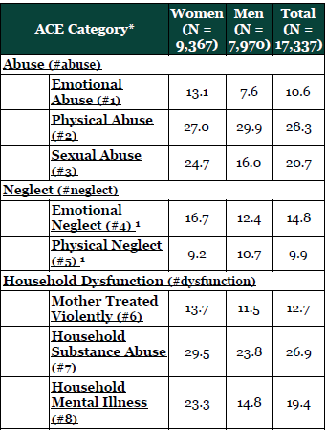
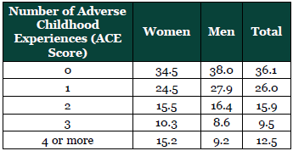
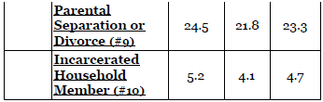

Adverse Childhood Experience
“Secondary prevention of the effects of adverse childhood experiences will first require increased recognition of their occurrence and second, an effective understanding of the behavioral coping devices that commonly are adopted to reduce the emotional impact of these experiences.” Kaiser ACE Study (1997)

Slide 15
ACES Study Findings…
Notes:
Ace of 6 or more equates to 20 years shorter life

Slide 16
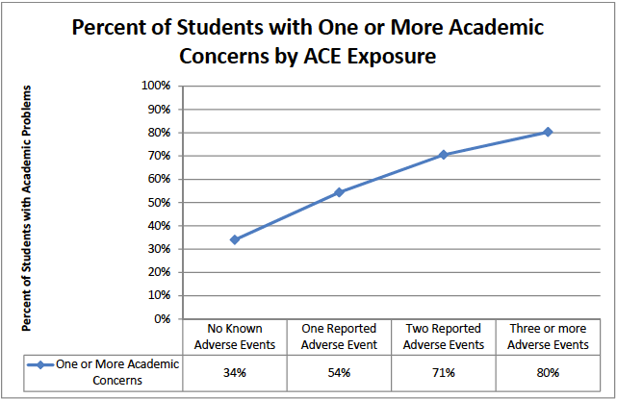
Spokane ACE Study 2010
2,100 children / 10 elementary schools
248 children (3 or more experiences)
  3 x rate of academic failure, 5 x rate of chronic truancy, 6 x rate of behavior problems 4 x rate of poor health
Christopher Blodgett, Director of the Area Health Education Center of Eastern Washington at Washington State University
Notes:
248 three or more adverse childhood experiences had three times the rate of academic failure, five times the rate of severe attendance problems, six times the rate of school behavior problems, and four times the rate of poor health compared with children with no known trauma

Slide 17

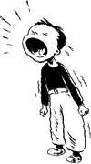

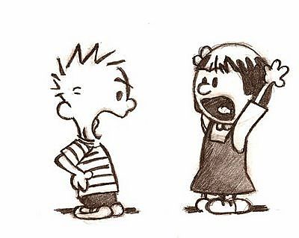
What Might You Notice?
Physical and Mental Health Symptoms | Emotional Regulation Challenges
Learning Difficulties | Relationship Difficulties
Notes:
Not every kid reacts to trauma in the same way. Some students Internalize—stop having emotions because they weren’t responded to anyway. Other students Externalize—have really big emotions that escalate easily and can’t be controlled
Note that Anger, fear, anxiety are ALL appropriate reactions to trauma
Physical and mental health symptoms: headache, stomachache, depressed, anxiety/worry about safety of self and others, Repetitive thoughts or comments about death or dying, reactivity and impulsivity, Over- or underreacting to loud noises or sudden movements (like PTSD), Withdrawal/avoidance of certain situations and people
Emotional Regulation Challenges: (We learn emotional regulation from our caregiver) Difficulty or inability to regulate emotions, Emotional response doesn’t “match” situation, Non-age appropriate behavior, reacts negatively or is overwhelmed by praise or positive attention
Learning Difficulties: Struggle maintaining attention or focus, Poor or changed school performance/attendance
Relationship Difficulties: Inability to work well with peers or in groups, Defiance toward rules or authority, Overly protective of personal space/belongings, Perfectionist/unrealistic expectations of self and others, Inability to take another’s perspective

Slide 18
Impact of trauma on Child Development
Trauma causes brain to adapt in ways that contributed to their survival (i.e. constant fight/flight/freeze).
These adaptations can look like behavior problems in “normal” contexts, such as school.
When triggered, “feeling” brain dominates the “thinking” brain.
The typical developmental process is interrupted, and students may exhibit internalizing or externalizing behaviors.
Notes:
Kids who experience complex or chronic trauma may always be “activated” or in “fight/flight/freeze”. Record player groove. Remember the idea of use it or lose it? Most used neural pathways have the strongest connections! Over time, exposure to trauma leads to physiological adaptations in the brain and body.
Fight or flight response is a stress response that should only be activated when in danger, and constant stress impacts brain development
Children will be aroused by even the perception of threat. Trauma undermines a young person’s ability to:
Regulate emotions
Develop a sense of self and exhibit appropriate interpersonal realtionships
Feel safe to explore
Tolerate new situations and change.

Slide 19

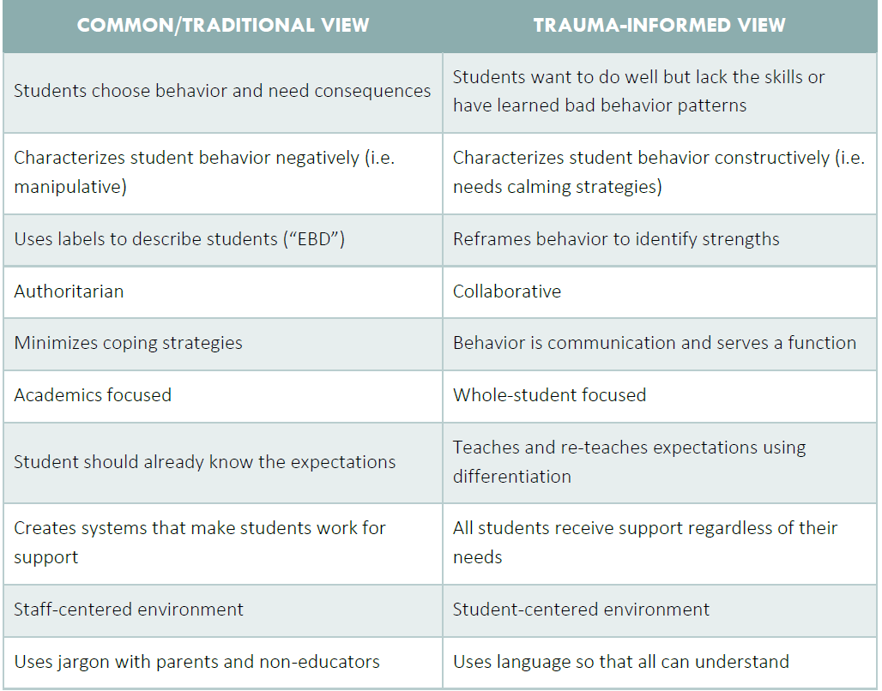
Consider this…
Notes:
Go through the thoughts of the traditional view and then the trauma informed view to show the suggested perspective to use so that we can better serve our students who have been experienced trauma.

Slide 20
Good Practices for Trauma-Informed Schools and Classrooms
Create a predictable, consistent classroom environment.
Provide explicit preparation for transitions and changes in the school, classroom.
Create a safe school and classroom environment, where bullying, fights, crises, etc. are responded to quickly, consistently, and respectfully.
Provide opportunities for teachers and other adults to build meaningful relationships with students in and out of the classroom.
Provide opportunities for students to build meaningful relationships with one another.
See Seneca Handout
Partner discussion: How are we achieving or working towards these practices at our site?
Notes:
These are practices that are in complete alignment with great PBIS implementation.
After going through the slides, give teams 5 minutes to discuss and share their thoughts…

Slide 21

Time to play!
Pretend you are at the beach…
As a team, see how long you can keep the ball in the air by gently passing it to each other.
After one team member bumps the ball, another member must bump it.
Count the number of bumps.
If the ball hits the ground, your team sits down.
The team with the most bumps wins!
Notes:
Play this game for about 10 minutes ☺

Slide 22
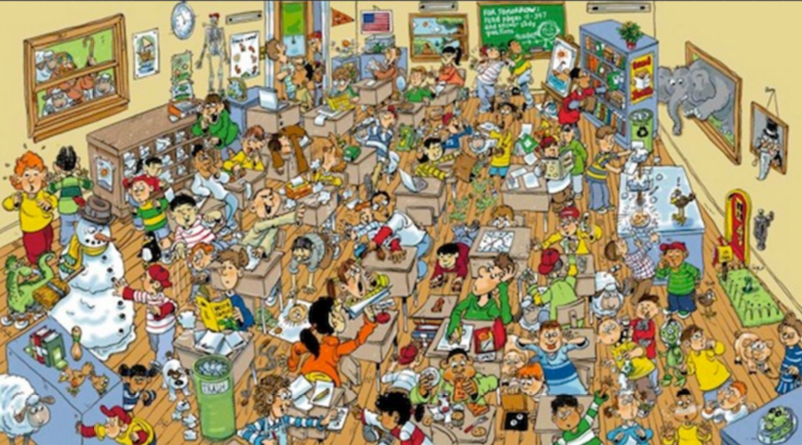
PBIS in the Classroom

Slide 23
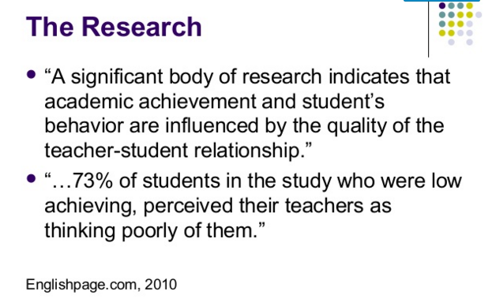
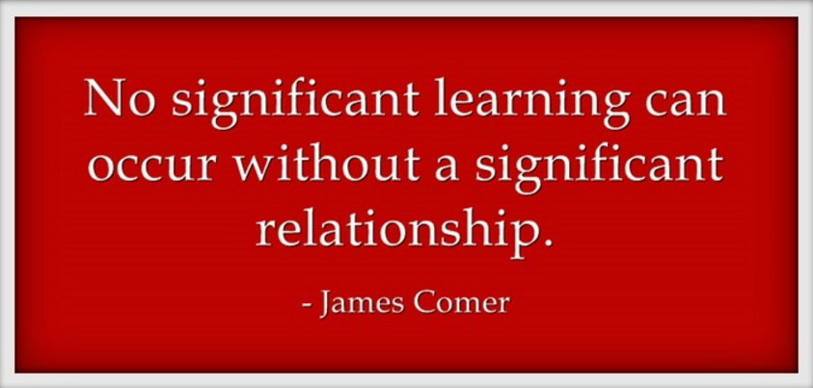

What the research says…
Notes:
The research shows that students desire a relationship with their teachers. When they feel connected, they perform better both in behavior and academics.

Slide 24
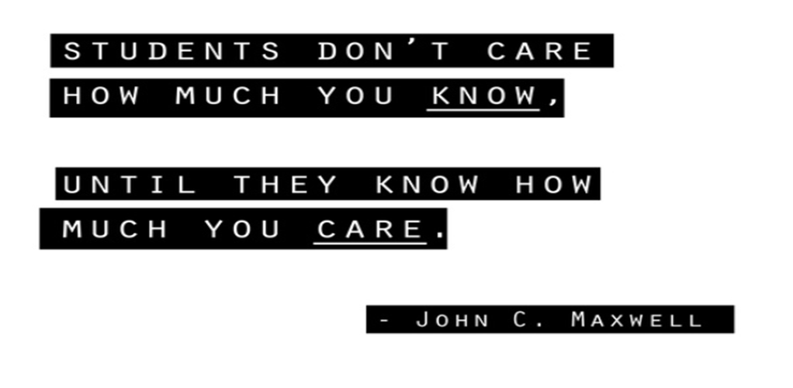
Relationship Building Strategies
Values Activity
‘ME’ posters
Interests collage
Community circles
5:1
Icebreakers (i.e. name game, web game)
Notes:
Values Activity—Give each student a small colored index card and ask them to write down one word that describes what they see as the most important value that should be embraced for the classroom (i.e. honesty, respect, integrity, etc.) Ask all student to stand up in a circle and then ask each student to share their card and explain why they chose that word. Put them up on a bulletin board or poster and create a circle using all of their words. Put similar words together and show how they all value very similar things and how it lines up with our classroom expectations around being safe, respectful and responsible. Continue to use your bulletin board/poster to highlight throughout the year, but especially when you see those values being displayed or when they have not been displayed and then you can create a conversation about how it was a value that everyone agreed on and then discuss why the behaviors might have happened and how we can repair the harm done.
‘ME’ posters—Everyone (including the teacher) create a poster that describes themselves…using words, pictures, places, things, etc… that give a snapshot of yourself.
Interests collage—pictures, drawings, etc. of things you’re interested in and take time to share out…
Community circles—First 5-10 minutes of class to just connect about the day, check in to see how they’re feeling, etc…
Or can be more structured into weekly meetings with agendas and issues to discuss.
5:1—For every negative/corrective comment there should be 5 positive interactions
i.e. ‘The whole class bombed this test.”
“Why do you guys always leave the balls on the court?”
Icebreakers—Name game– My name is Diane and I would like to travel to Denmark
Web game—Stand in a circle and start with a ball of yarn and share one thing about yourself that others may not
know, then toss the ball of yard to someone on the other side of the circle, they share something about themselves, and then they toss it across the circle, and keep going

Slide 25


Building relationships is essential…
  2:10 Strategy
    2 minutes a day for 10 days with your most challenging student
  TUMS
    Touch (High 5, fist bump, elbow bump, handshake, hug)
    Use their name in a meaningful sentence.
    Make eye contact.
    Smile ☺
  Positive phone calls/notes home
Notes:
2:10 Strategy– Spend 2 minutes every day for 10 days with your most difficult student. Let them help you choose when it will work for both of you and then tell them that they can talk about anything they would like to talk about (as long as it’s ‘G’ rated…)
TUMS—
T—Touch every student as they enter your classroom (high five, handshake, fist bump, elbow bump, hug)
U—Use their name in a meaningful sentence. (Great to see you Lisa. I saw your mom at the store last night. )
M—Make eye contact (even if it’s not part of their culture, they will appreciate that you are looking at them…)
S—Smile (genuinely smile at them)
If the time is taken to intentionally teach expectations and routines and take the time to reteach when mistakes are made, the problem behavior will be less likely to occur. Use the planning checklist to help make sure that all routines are taught and expectations clearly communicated.
Punitive measures typically do not change bad behavior in the classroom.
Building relationship with the student and family is essential… If the student and their family feels that you genuinely care about them and are concerned about their success and willing to help them through their mistakes, you will have more success. Connect with the family when the student has had a good day! Focus on the positive.

Slide 26


Time to move around!
Choose one of the posted strategies around the room.
Walk to the sign of the strategy you will try.
Discuss with your group how and when you will implement this new strategy.
Notes:
Use signs for the relationship building strategies and put up in the room.

Slide 27

Why should we focus on this?
The research shows that in order for a PBIS implementation to be successful and to be sustained over time, there must be PBIS happening in the classroom.
PBIS in the classroom includes:
  Teaching school-wide expectations
  Explicitly teaching classroom routines
  Using positive acknowledgements
  Using an in-class continuum of consequences
  Proactive and preventive interventions
Notes:
It is essential to focus on the essential features of PBIS so that we can continue experiencing the benefits that the research suggests. We want our positive school climate and all of the efforts we’ve made with PBIS to continue on for years to come.

Slide 28
Tiered Fidelity Inventory
TFI 1.8 Classroom Procedures:
Tier 1 features (school-wide expectations, routines, acknowledgements, in-class continuum of consequences) are implemented within classrooms and consistent with school-wide systems.
Possible Data Sources:
Staff Handbook
Informal Walk-throughs
Progress Monitoring
Individual Classroom Data
Notes:
This work is based on the TFI 1.8. Remind the participants about the possible data sources so they know where they can begin.

Slide 29
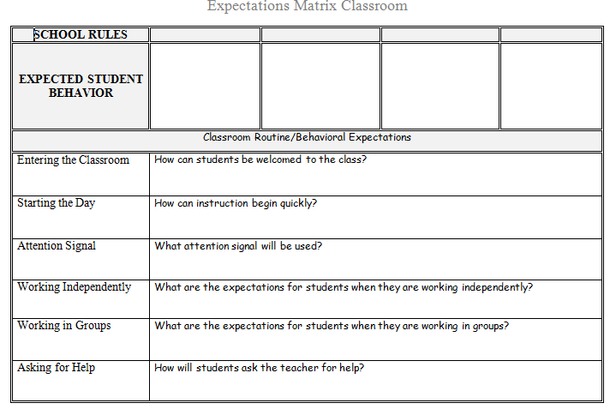
Classroom Expectations & Routine
Start with clear expectations…
Document 10
PBIS Team or individual teachers fill in this section. Solicit feedback!
Individual teachers or teams fill in this section.
Notes:
Remind site teams that teaching the expectations includes classroom routines.

Slide 30

Reflection:
Which of the following PBIS practices is the strongest in the classrooms at your site? Which needs the most support?
  Classroom routines and expectations are clearly defined and posted
  Classroom routines and expectations are directly taught
  Classroom teachers frequently acknowledge appropriate behavior and use specific praise to connect these behaviors to the school-wide expectations
  Classroom teachers respond to inappropriate behavior using a primarily instructional approach that is consistent with the school-wide system
What sources of data could you use to better define the fidelity of the implementation of these practices?
Notes:
Ask teams to reflect for 5 minutes and then get their feedback. Then bring up orange square information and talk about the sources of data.
Often times teachers on the team are aware of what they do in their classrooms, but not what other teachers do. Refer back to the TFI data sources. (Staff handbook, informal walkthroughs, progress monitoring and individual classroom-(behaviorist data, admin observations, coach observations) Many times it is the admin who has walkthrough or individual classroom data.

Slide 31

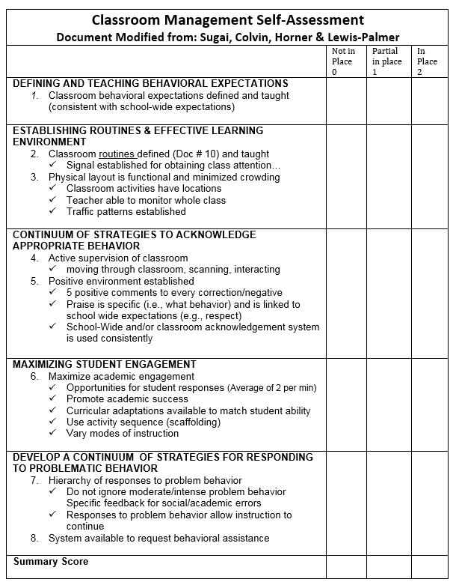
Self Assessment
Notes:
This assessment includes the researched evidence-based features of classroom management that align with PBIS essential features. The intent is to create an opportunity for staff to reflect on their own practices. They can take it anonymously at a staff meeting and then the PBIS team can tally areas that need additional professional development or training.

Slide 32
Using the Self Assessment
Have every teacher complete the self-assessment at a staff meeting (anonymously)
PBIS team tallies the scores and identifies area of need
PBIS team provides brief presentation on area of need at staff meeting/PD time
Teachers action plan alone, in partners, or in teams
Action plans are reviewed briefly at each meeting and the assessment is given as needed
Notes:
This is a suggested use of this form.

Slide 33

Example: Self Assessment
3
7
Select area the staff rates as lowest
Consider using data form for baseline data and to confirm area of need
Provide short professional development on this area
Provide time for action planning
2
8
1
2
7
6
4
2
8
Notes:
A possible way that the form can be used as a data source to create meaningful opportunities for professional development for the staff.

Slide 34

Team Activity & Discussion
Guiding question | Team task | Use
How will your team support PBIS practices in the classroom? | Schedule when you might give the Self Assessment Schedule out time to review classroom PBIS practices at future staff meeting (after assessment is complete) | Document 96
How will you ensure your students know the classroom expectations | Develop a plan to ensure that the classroom expectations and routines are taught to all students. | Document 10
Notes:
Reinforce the need for a strong PBIS in the classroom to create longevity and sustainability for PBIS. The more we can focus on great classroom implementation with fidelity, the better our chances are for PBIS to be sustained school-wide. The adoption of the evidence-based features in the classroom will create a better school culture and climate overall.

Slide 35


Stop, Walk and Talk
Expect Respect--
Bully Prevention
Adapted from:
Scott Ross & Rob Horner
Utah State University and University of Oregon
Notes:
We will be including Bully Prevention in our Tier 1 training moving forward, but wanted to introduce you to the curriculum and give you some time as teams to figure out a workable way to include school-wide Bully Prevention at your site.

Slide 36
Bully Prevention within PBIS Implementation
School-wide Expectations
-------------------
Define, Teach Acknowledge, Data System, Consequence System
Classroom Systems
Bully Prevention
Notes:
Bully Prevention fits well with the Tier 1 implementation, as it addresses overall school-wide expectations focusing on how we treat others, as well as how to respond in a bullying situation. Combined with school-wide expectations and classroom systems, it provides a comprehensive approach school-wide recognition of bullying behaviors as well as what to do when you are the victim, one who is displaying bullying behavior or a bystander.

Slide 37

The Logic:
Why invest in Bully Prevention?
The National School Safety Center (NSSC) called bullying the most enduring and underrated problem in U.S. schools.
(Beale, 2001)
Nearly 30 percent of students have reported being involved in bullying as either a perpetrator or a victim.
(Nansel, et al., 2001; Swearer & Espelage, 2004).
Victims and perpetrators of bullying are more likely to skip and/or drop out of school.
(Berthold & Hoover, 2000; Neary & Joseph, 1994)
Victims and perpetrators of bullying are more likely to suffer from underachievement and sub-potential performance in employment settings.
(Carney & Merrell, 2001; NSSC, 1995).
Notes:
This is research that supports the work of bully prevention.

Slide 38
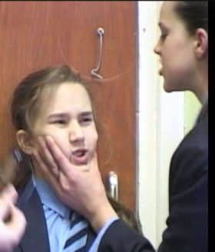
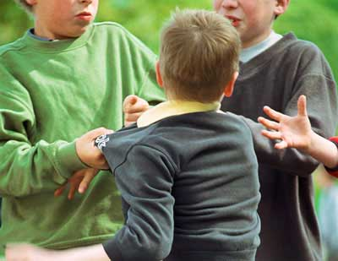
What is Bullying?
“Bullying” is aggression, harassment, threats or intimidation when one person has greater status, control, power than the other.”
Notes:
The term ‘bullying’ is often times overused. This is a definition that you can share with your teams and school staff to help give clarity to the term.

Slide 39

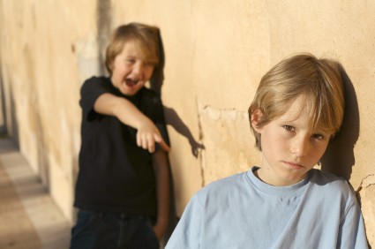

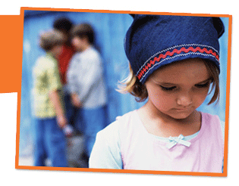
What do you see?
Notes:
These are pictures of potential bullying incidents on a school campus.. Ask for teams to create potential scenarios that fit with the pictures above.

Slide 40
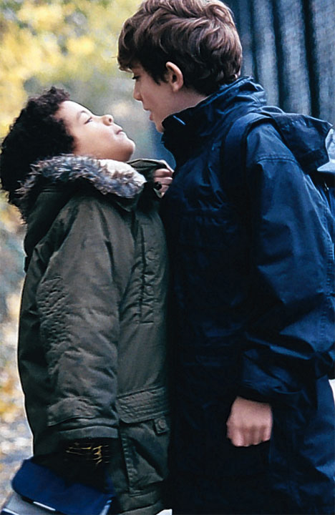
Why invest in School-wide bully prevention?
Most Bully Prevention programs focus on the bully and the victim
    Problem #1: Inadvertent “teaching of bullying”
    Problem #2: Blame the bully
    Problem #3: Ignore role of “bystanders”
    Problem #4: Initial effects without sustained impact.
    Problem #5: Expensive effort
What do we need?
    Bully prevention that “fits” with existing behavior support efforts
    Bully PREVENTION, not just remediation
    Bully prevention that is sustainable.
Notes:
The curriculum provided on pbis.org fits it well with the Tier 1 expectations and lessons for expected behaviors. It gives the opportunity to teach, role play and reteach, if necessary.

Slide 41

A three part approach to school-wide
Bully Prevention
Establish a whole-school social culture where positive behavior is “expected” and rewards for bullying are NOT provided.
Provide training and support for adults to
(a) train, (b) precorrect, and (c) provide
consequences for bullying
Provide direct, individualized support for students who engage in “bullying” or “victim” behaviors.
Notes:
This 3 part approach is directly in line with Tier 1 PBIS implementation.

Slide 42


Bully Prevention Curriculum
Free resources:
  http://www.pbis.org/school/bully-prevention
Notes:
This is the link for the free curriculum download. Go to the link and show the curriculum and how to teach it… ;)

Slide 43



Guiding question | Team task | Use
How will you incorporate the Bully Prevention Curriculum into your PBIS lessons? | Develop a plan to include the Bully Prevention lessons with your PBIS expectations lessons. | School Year Calendar/ Action Plan
Notes:
Give teams 10 minutes to work and explain that they will have more time during the allotment of team time later.

Slide 44

Planning for Preservice and Kickoff
Notes:
Planning for a kickoff ahead of time gets your year off to a strong start. ☺

Slide 45

Preservice/Kickoff
Why a big Kick-Off Day?
  Communication of school-wide cultural shifts
  Commonalities in language and expected behaviors
Who is involved?
  Staff: decide who will present; who will monitor; who is in charge of what
  Parent/Community: participating? Responsibility? Presenting?
What do you teach?
  Positive behaviors for each area of your matrix
Where do you focus the rotations?
  In your agreed upon common areas
  Historic or potential problem areas??
When do you do the “Big Day”?
  Whenever it is right for your school…
Notes:
Schools that plan for intentional teaching of expected behaviors and a big school-wide event experience more successful implementation of PBIS. The students and staff are more bought-in and the awareness of ‘who we are’ is more clearly understood. It is a great way to build in school spirit and identity, as well.

Slide 46

Rotations and Lessons
When considering where the rotations will take place and what you will be teaching in each specific location, remember that you should:
  Teach the School-Wide AND Classroom Matrix
  Use lesson plans and/or scripts for consistency
  Create a do-able rotation schedule (see handout example)
  Use the school map to visually represent your rotations
Create checklists (see handout example)
Inform your community and district about your big day!
Have enough acknowledgement tickets on hand—start recognizing the expected behaviors immediately!
Consider using a “passport” for students to document their travels for the day. (see handout example)
Notes:
Rotations are great for elementary schools and can also be pulled of in middle schools. High schools are a bigger challenge, but could be done through an advocacy or advisory class. Some high schools use Link Crew and their Freshman Seminar, too.

Slide 47
Team Activity & Discussion
Guiding question | Team task | Use
How will your team present PBIS to the staff at Preservice? | Plan Preservice Presentation and Activities. | Kickoff Packet Documents
How will you do a ‘kickoff’ event for the beginning of your school year? | Decide how you will create activities and a plan to begin your school year strong. | Kickoff Packet Documents

Slide 48

Team Work Time!!!

Slide 49


Now what…??
Celebrate all that you’ve done this year!
Review Tier 1 Checklist items that need attention.
Review your SAS, POI and TFI Action Plans to determine which items are your priority for today.
Create a concrete plan with who is responsible and a time frame as you continue to move forward!

Slide 50
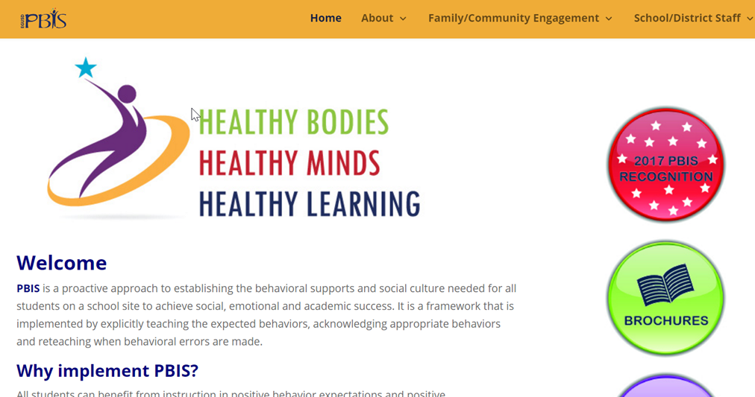
Helpful Resources…
EGUSD PBIS Website!
  EGUSD Main Website
    Students and Families Tab → Wellness → Positive Behavioral Interventions and Supports
www.pbis.org
Behavior Management Strategies—pbisworld.org

Slide 51
Guiding question | Team task | Use
What are your top 3 action plan items to work on today? | Begin by prioritizing the work for today and delegate responsibilities to each team member. | SAS, POI and TFI Action Plans PBIS Tiers 1 & 2 Checklists
Notes:
Give teams 15-20 minutes to work on creating their own checklist.

Slide 52


Thank you!
Contact information:
Lisa Vartanian (PBIS Program Specialist)—lvartani@egusd.net
Diane Stevenson—ddsteven@egusd.net
Holly Smallie—hsmallie@egusd.net
Brian Patterson—bpatters@egusd.net
Nancy Olson—nolson@egusd.net
Charlie Hill—chhill@egusd.net
Moriah Brasel—mbrasel@egusd.net
Amanda Murillo—ammurill@egusd.net
Susannah Fox—sufox@egusd.net
Khadijah Al-Faraj—kalfaraj@egusd.net
Monica Lopez—mnlopez@egusd.net

