Slide 1
PBIS Tier 2 Day 1 Team Training Developing Tier 2 Systems and Interventions

Slide 2
E4—Where do we fit?

Slide 3
Model of Skill Relationships
Student Response to Instruction and Classroom Environment
Teaching and Learning Progression
Classroom
Instruction
Academic Enablers
Academic Proficiency/
Mastery
Academic Skills
Interpersonal
Engagement
Motivation
Study Skills
Understanding the essential link between the Common Core State Standards and direct behavioral instruction.
Adapted from Diperna & Elliott, 2000; Elliott, DiPerna & Shapiro, 2001

Slide 4
Training Expectations
Be Safe
Watch for power cords
Keep belongings tidy to prevent trips
Be Respectful
Disconnect to connect
Listen during presentation time
Be Engaged
Participate fully with your team
Use team time to complete tasks
Share ideas for support
Question to clarify
Listen to learn

Slide 5
Overview of Tier II PBIS Training
Date | Content
Day 1 | Solidify Tier I Practices Classroom and TIPS Extension Stop, Walk and Talk/Expect Respect—Bully Prevention Navigating PBIS Assessment Intervention Team Established Communication System for Tier I and Tier 2 Teams
Day 2 | Intervention Team Roles/Template Identifying Students for Tier 2 Identifying Community Supports
Day 3 | Check in Check Out Roles Identified Check In Check Out Process Check in Check Out Communication System
Day 4 | Assess fidelity and outcomes in CICO Decision Rules Established Targeted Intervention Guide Strong Kids/Teens Intervention
Notes:
This provides an overview for the training for the year.

Slide 6
Acknowledgments
PBIS Technical Assistance Center
Co Directors: Dr. Rob Horner, University of Oregon & Dr. George Sugai, University of Connecticut
Celeste Rossetto-Dickey, University of Oregon
Dr. Chris Borgmeier, Portland State University
Dr. Cindy Anderson, West Virginia University
Jessica Swain-Bradway, Midwest PBIS Network
Notes:
We always acknowledge the work of the PBIS Technical Assistance Center. The PCOE training materials are based on the Training Blueprint on the www.pbis.org site. PBIS Training sites use this blueprint across the United States and internationally.

Slide 7
Tools for the day
PBIS Tier 2 Binder
Tier 2 Day 1 Packet
Tiered Fidelity Inventory
EGUSD PBIS Website
http://www.egusd.net/students-families/wellness/
Notes:
Take time to review all the materials for today. Binders are provided for the team lead and team coach. Teams must use laptops to access the Placer County website. Go to the website and demonstrate how to log in and access the materials. Review the pages in the Day 1 packet. Remind participants that some materials are in the binder but all materials are on the website. The packet contains the documents most needed by the team today for collaboration. The Tiered Fidelity Inventory will be completed and a copies are on the tables for the team members to review when completing the survey.

Slide 8
Let’s have some fun!
Everyone stand up!
Be ready to catch the beach ball.
Read the question that your right thumb is closest to…
Share your answer to the question with the group. ☺

Slide 9
Training Objectives
Tier I Extension Activity: Class-wide PBIS and TIPS
Solidify Tier I Systems and Practices
Share Out Tier I Progress
Solidify Intervention Team
Tier 2 Overview
Identify Communication Strategy for Tier I and Tier 2 Teams
Notes:
The training objectives are the tasks for the day. The training will move through the objectives. At the end of the training, teams will have time to review their progress and develop an action plan on the day’s tasks.

Slide 10
Let’s hear from you!
Introduce your team and then choose a success to
share:
Choice #1
Identify a school-wide success, share how your PBIS team contributed to the success.
Choice #2
Share a success in building “Buy-in” for PBIS at your school site.
Choice #3
Identify a Tier 2 success that you would like to be able to share at this time next year.
Notes:
Ask teams to take 5 minutes to discuss and be ready to share out.

Slide 11
PBIS in the Classroom

Slide 12
Tiered Fidelity Inventory
TFI 1.8 Classroom Procedures:
Tier 1 features (school-wide expectations, routines, acknowledgements, in-class continuum of consequences) are implemented within classrooms and consistent with school-wide systems.
Possible Data Sources:
Staff Handbook
Informal Walk-throughs
Progress Monitoring
Individual Classroom Data
Notes:
This work is based on the TFI 1.8. Remind the participants about the possible data sources so they know where they can begin.

Slide 13
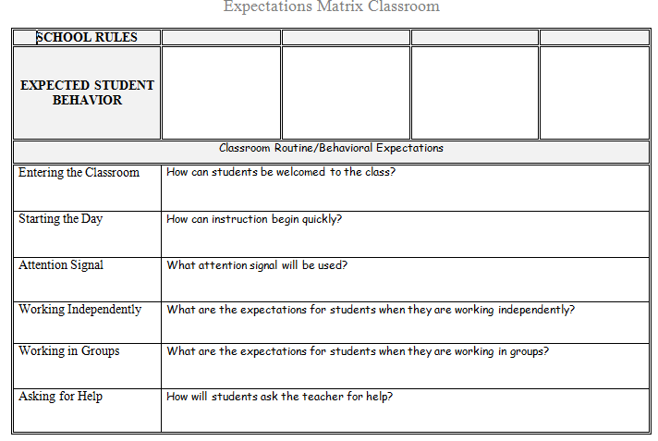
Classroom Expectations & Routine
Start with clear expectations…
Document 10
PBIS Team or individual teachers fill in this section. Solicit feedback!
Individual teachers or teams fill in this section.
Notes:
Remind site teams that teaching the expectations includes classroom routines.

Slide 14
Reflection:
Which of the following PBIS practices is the strongest in the classrooms at your site? Which needs the most support?
Classroom routines and expectations are clearly defined and posted
Classroom routines and expectations are directly taught
Classroom teachers frequently acknowledge appropriate behavior and use specific praise to connect these behaviors to the school-wide expectations
Classroom teachers respond to inappropriate behavior using a primarily instructional approach that is consistent with the school-wide system
What sources of data could you use to better define the fidelity of the implementation of these practices?
Notes:
Ask teams to reflect for 5 minutes and then get their feedback. Then bring up orange square information and talk about the sources of data.
Often times teachers on the team are aware of what they do in their classrooms, but not what other teachers do. Refer back to the TFI data sources. (Staff handbook, informal walkthroughs, progress monitoring and individual classroom-(behaviorist data, admin observations, coach observations) Many times it is the admin who has walkthrough or individual classroom data.

Slide 15
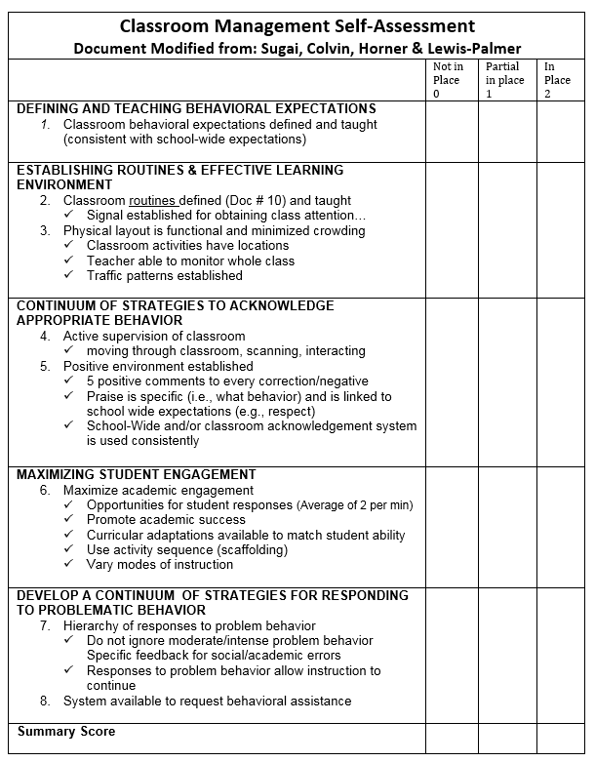
Self Assessment
Notes:
This assessment includes the researched evidence-based features of classroom management that align with PBIS essential features. The intent is to create an opportunity for staff to reflect on their own practices. They can take it anonymously at a staff meeting and then the PBIS team can tally areas that need additional professional development or training.

Slide 16
Using the Self Assessment
Have every teacher complete the self-assessment at a staff meeting (anonymously)
PBIS team tallies the scores and identifies area of need
PBIS team provides brief presentation on area of need at staff meeting/PD time
Teachers action plan alone, in partners, or in teams
Action plans are reviewed briefly at each meeting and the assessment is given as needed
Notes:
This is a suggested use of this form.

Slide 17
Example: Self Assessment
3
7
Select area the staff rates as lowest
Consider using data form for baseline data and to confirm area of need
Provide short professional development on this area
Provide time for action planning
2
8
1
2
7
6
4
2
8
Notes:
A possible way that the form can be used as a data source to create meaningful opportunities for professional development for the staff.

Slide 18
Student Engagement: Opportunities to Respond

Slide 19
Definition: Opportunities to Respond
A teacher behavior that prompts or solicits a student response (e.g., asking a question, presenting a demand). OTRs include:
Individual or small group questioning: use a response pattern to make sure that all students are called on
Choral Response: all students in a class respond in unison to a teacher question
Non-Verbal Responses: students respond using symbols, tools, or gestures
Notes:
Give overview of the definition. Many of us do this without even thinking about it. The research supports the importance of giving students opportunities to respond and how it correlates with student engagement.

Slide 20
Non-Example
Notes:
Ask what was wrong with the teacher’s style of teaching? How could it have been improved?

Slide 21
And the research says…
When teachers increase their rates of opportunities to respond:
Students learn more by spending more time activity engaged in material
More material can be covered
Student on-task behavior and correct responses increase while disruptive behavior decreases
(Barbetta, Heron, & Howard, 1993; Carnine, 1976; Heward, 1994; Sutherland, Alder, & Gunter, 2003; Sutherland & Wehby, 2001; West & Sloane, 1986).
Notes:
Study that was done when teachers intentionally increase their rates of OTR’s.

Slide 22
OTR Strategies
Varied and creative strategies exist
Verbal strategies–students respond to teacher prompts or questions:
individual questioning
choral response
Non-verbal strategies–students use a signal, card, writing or movement to respond:
white boards
response cards
student response systems (clickers)
symbols
guided notes
Notes:
Being creative with verbal and nonverbal strategies gives variety to the learning experience.

Slide 23
Verbal Response Strategies
Example 1: When I say respond and drop my hand, tell me what OTR stands for…
Choral Response: All students
in class respond in unison to a teacher question.
suitable for review, to teach new skills, as a drill, or as a lesson summary
demonstrated at all grade levels, K-12
Example 2: When I say respond and drop my hand, tell me what it’s called when all students respond in unison…
Notes:
Highlight the examples of different ways teachers can elicit a choral verbal response.

Slide 24
Tap on your desk each time you hear the teacher provide an opportunity to respond:
Notes:
We can practice one strategy of giving students the opportunity to respond by tapping on their desks.

Slide 25
Non-Verbal Response Strategies
White Boards: students have personal white board to write answers to teacher’s questions.
When cued, hold up board to display answers.
i.e. “When I say ‘flip it’, show me your
answer.”
i.e. “I will count down from 3, and then show me your answer.”
Notes:
White boards are a great way to get immediate individual feedback.
Small white boards can be purchased at dollar stores. Another option is going to Home Depot and asking for them to cut the large piece of whiteboard materials into appropriate sizes for the students. They can use socks for erasers..

Slide 26
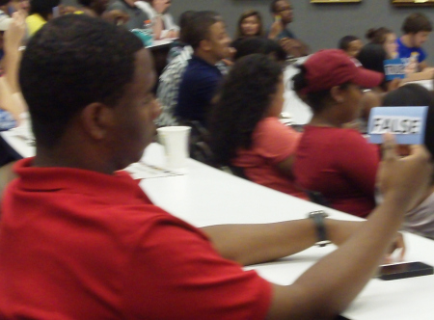
Non-Verbal Response Strategies
Response Cards: pre-printed cards that have words on both sides.
Yes/No
True/False
Odd/Even
Card set of few choices
i.e. noun, pronoun, verb, adverb
i.e. addition, subtraction, multiplication, division
i.e. setting, rising action, falling action, conclusion
Notes:
These can be prepared ahead of time that could be used for various lessons. If you laminate the cards, they will last much longer.

Slide 27
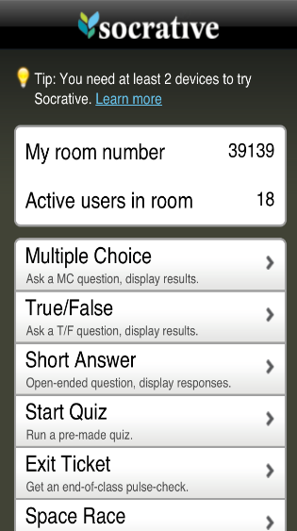
Non-Verbal Response Strategies
Use student cell phones in a positive way:
Two outstanding free resources that can transform student cell phones and smartphones into handheld classroom response systems:
Poll Everywhere
Socrative
~Information taken from teachinghistory.org: Cell Phones as Classroom Tools
Notes:
Depending on the age of the students, this could be an appropriate strategy.

Slide 28
Non-Verbal Response Strategies
Signaling or Movement Activities:
Thumbs up/thumbs down
Stand up/sit down
Move to four corners, etc.
Raise your right/left hand
Give me a ‘silent cheer’
Use sign language ‘yes’
Fist of five (for quick assessment)
Notes:
Try this strategy with the group.
Ask simple questions and have the participants do a thumbs up/down or stand up/sit down.
Questions like:
Who drove to the training today?
Are you ready for a break?
Have you learned anything new with this module?

Slide 29
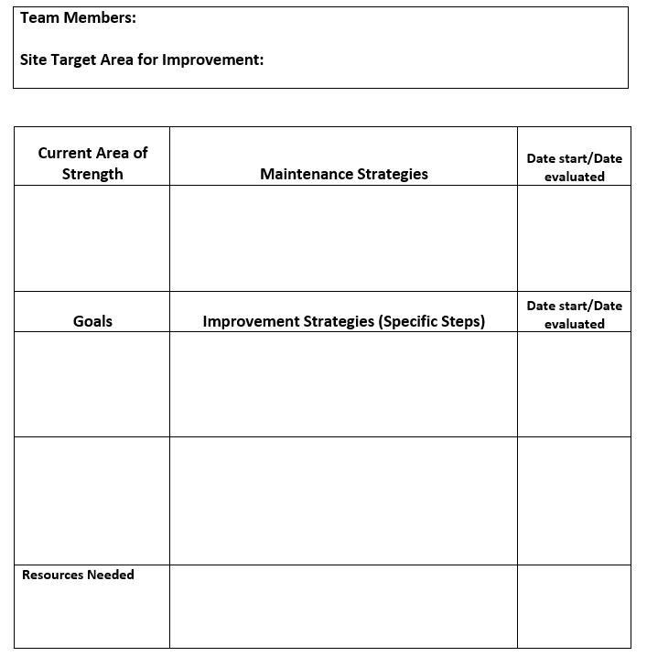
Action Plan, Document 96
4th Grade: Luke, Kerri, Denae, & Alisha
Engagement: OTR
Acknowledge Appropriate Behavior
Continue to use school-wide acknowledgement system and team points
1/1/17
2/1/17
Increase OTRs to at least 1 for every 2 minutes
Use white boards and choral responding during math period.
Include prompts in lesson plan
1/1/17
2/1/17
Class set of white boards
Notes:
Use this action plan to set some goals for yourself regarding the use of OTR’s. This form can be shared with the staff to create their own professional development moving forward.

Slide 30
Team Activity & Discussion
Guiding question | Team task | Use
How will your team support PBIS practices in the classroom? | Schedule when you will give the Self Assessment Decide who will conduct observations and when Schedule out time to review classroom PBIS practices at future staff meeting (after assessment is complete) | Document 96
How will you ensure your students know the classroom expectations | Plan to ensure the classroom expectations matrix is completed | Document 10
Notes:
Reinforce the need for a strong PBIS in the classroom to create longevity and sustainability for PBIS. The more we can focus on great classroom implementation with fidelity, the better our chances are for PBIS to be sustained school-wide. The adoption of the evidence-based features in the classroom will create a better school culture and climate overall.

Slide 31
Team Initiated Problem Solving (TIPS) Review

Slide 32
Team-Initiated Problem Solving II
(TIPS II) Model
Identify Problem
with
Precision
Make Summative
Evaluation
Decision
Identify Goal
for Change
Collect and Use Data
Monitor Impact of
Solution and
Compare Against
Goal
Identify Solution and
Create Implementation
Plan with Contextual
Fit
Implement
Solution with
High Integrity
Meeting
Foundations
Notes:
Refer to the table tents: the focus of this section of the training is on Meeting Foundations, which is the “backbone” of the problem solving process.

Slide 33
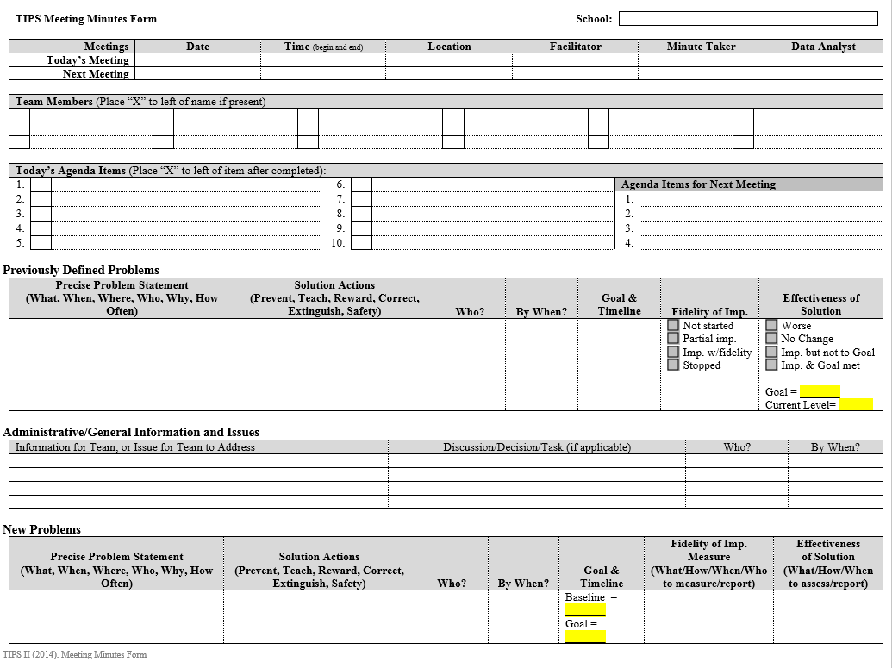
Document 45b
Notes:
Minute forms used by site teams to track and monitor school wide efforts, as well as maintain accountability for team members’ attendance and action items. Keeps flow of meeting business-like, and away from unneccessary or side-bar discussions. Form keeps team attention on data- both fidelity (adult behavior) and outcome data (student behaviors). Allows for team to acknowledge successes and action planning for areas in need of improvement.

Slide 34
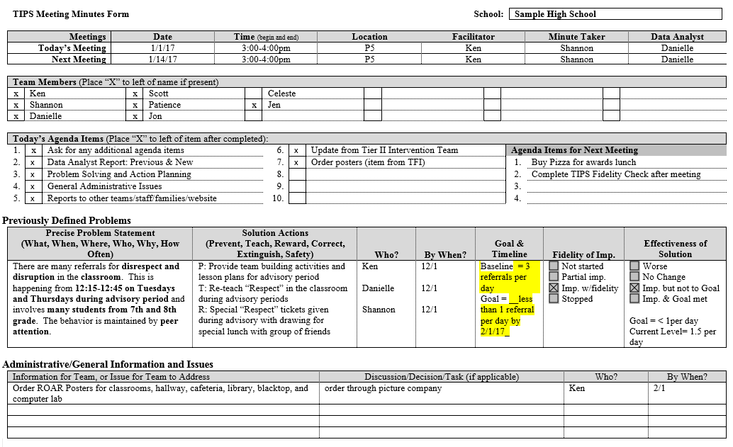
Document 45a
Respond
What is the baseline for the previously defined problem?
3 Referrals per day
When is the previously defined problem happening?
12:15-12:35
Who missed today’s meeting?
Celeste
What will the team complete at their next meeting?
Fidelity form
What is the problem behavior for the new problem?
Physical Aggression
Notes:
Whole group activity: Ask all participants for choral response to for the questions above: eg: “who missed today’s meeting?” Direct teams to the area of the form where they can find the answer, if necessary.

Slide 35
TIPS Team Roles
Team Facilitator/Lead
Minute taker
Data Analyst
Active team members
Administrator
Back-up for each role
Typically NOT
the administrator
Can one person serve multiple roles?
Are there other roles needed?
Notes:
We need primary people with a back up person for each role needed. It is encouraged to NOT have the administrator play a primary role for facilitator, data analyst, or minute taker. Administrators need to be flexible with what might come up and it is unpredictable when a situation causes administrator absence from a planned meeting. Since we know that this might occur, let’s avoid problems and set up the roles so that the team is not dependent on administrators being at the full meetings 100% of the time.

Slide 36
Team Work Time
Guiding question | Team task | Use
Are all of your roles still established? | Update roles and backups to team members and record these roles on the PBIS Team Roster | Team Role Descriptions: Document 101 Blank Team Roster: Document 102
When will the PBIS team be meeting this year? | Schedule PBIS team meetings for the school year. Teams should meet at least monthly for 45-60 minutes. | Electronic Calendar?
Notes:
Many attending sites in Tier 2 will already have meetings scheduled for the year, but it’s a good idea to ask if they have been meeting according to their scheduled dates ( or if meetings have been cancelled, low attendance, or combined w/ other initiatives).

Slide 37
Team-Initiated Problem Solving II
(TIPS II) Model
Identify Problem
with
Precision
Make Summative
Evaluation
Decision
Identify Goal
for Change
Collect and Use Data
Monitor Impact of
Solution and
Compare Against
Goal
Identify Solution and
Create Implementation
Plan with Contextual
Fit
Implement
Solution with
High Integrity
Meeting
Foundations
Notes:
Refer to the table tents: the focus of this section of the training is on Meeting Foundations, which is the “backbone” of the problem solving process.

Slide 38
Primary vs. Precision Statements
Primary Statements | Precision Statement
“Too many referrals.” | “There are more ODRs for aggression in the quad than last year. These are most likely to occur during first lunch, with a large number of students, and the aggression is related to gaining attention from peers.”
“September has more suspensions than last year.”
“Gang behavior is increasing.”
“The cafeteria is out of control!”
“Student disrespect is off the hook!”
What | Where | When | Who | Why
Notes:
Primary Statements
Too many referrals
September has more suspensions than last year
Gang behavior is increasing
The cafeteria is out of control
Student disrespect is out of control
Precision Statements
There are more ODRs for aggression on the playground than last year. These are most likely to occur during first recess, with a large number of students, and the aggression is related to getting access to the new playground equipment.

Slide 39
BASELINE = # of referrals in drill down (divided by) # of school days or weeks included in drilldown
Find baseline using datal
50 referrals / 25 days =
50 referrals / 5 weeks =
25 referrals / 10 days =
2 referrals per day
10 referrals per week
2.5 referrals per day
Notes:
Animated slide
Do the first baseline together and then cut them loose to practice each baseline. Ask group why establishing a baseline is important for their work in school wide PBIS. Point out the need to keep same mode of measurement.
Include in table tent

Slide 40
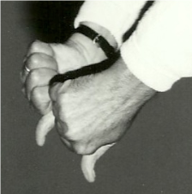
Goal or No Goal?
…is it SMART?
Specific
Measurable
Achievable
Realistic
Time Bound
Add “by When”
Reduce instances of 3rd & 4th grade disrespect on the playground to 1 per week (.20 per day) by end of the school year
Goal
Reduce tardies in 9th grade
Reduce instances of 3rd & 4th grade disrespect on the playground to no more than 1 time a day
No Goal
Add “by How Much” and “by When”
Reduce instances of 3rd and 4th grade disrespect on the playground to no more 5 per week by May 1st
No Goal
Add “ “by When”
Goal
Notes:
Choral response activity. Based upon the previous slide on Precision statements/goals: what, where, when, who, why…

Slide 41
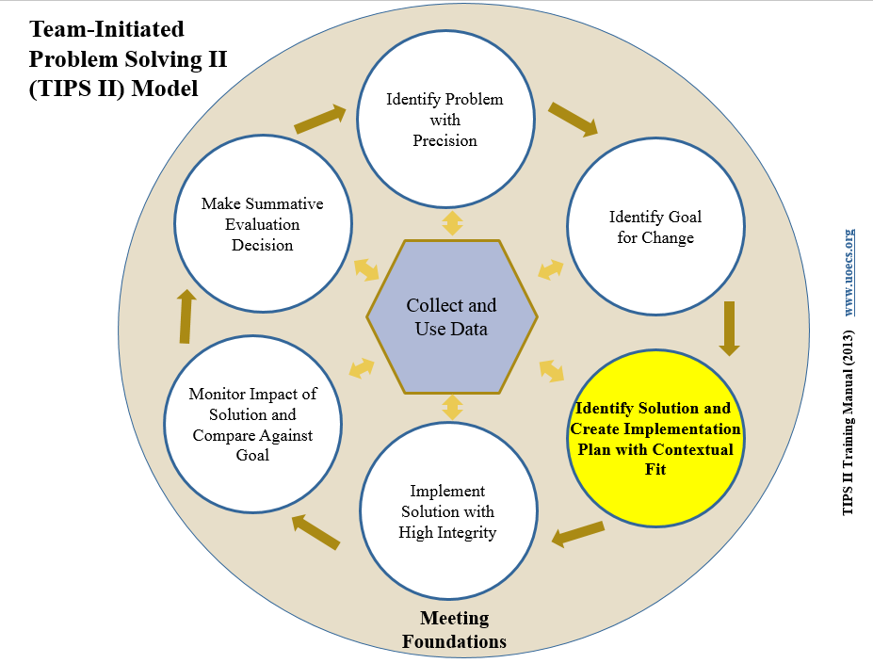
Solution Action Elements | Possible Generic Solution Actions
Prevent What can we do to prevent the problem? | Adjust physical environment. Define & document expectations and routines. Assure consistent & clear communication with all staff.
Teach What do we need to teach to solve the problem? | Explicit instruction linked to school wide expectations. Teach what to do, how to do it and when to do it. Model respect .
Reward What can we do to reward appropriate behavior? | Strengthen existing school wide rewards. Include student preferences. Use function-based reinforcers
Extinguish What can we do to prevent the problem behavior from being rewarded? | Use ‘signal’ for asking person to ‘stop’. Teach others to ignore (turn away/look down) problem behavior.
Correct What will we do to provide corrective feedback? | Intervene early by using a neutral, respectful tone of voice. Label inappropriate behavior followed by what to do Follow SW discipline procedures
Safety Do we need additional safety precautions? | Separate student from others if he/she is unable to demonstrate self-control. Make sure adult supervision is available.
Notes:
Examples of ways to address your precision Goals. Teams should consider more than one approach to creating a solution, based upon the nature of the presenting school-wide problem.

Slide 42
Goal: Use Precision Statement to Define Solutions
Precision Problem Statement
What
Where
When
Who
Why
Solution Action Elements
Prevent | What can we do to prevent the problem?
Teach | What do we need to teach to solve the problem?
Reward | What can we do to reward appropriate behavior?
Extinguish | What can we do to prevent the problem behavior from being rewarded?
Correct | What will we do to provide corrective feedback?
Safety | Do we need additional safety precautions?
L
Notes:
Framework slide that leads to example slide (to follow). Again, not all solution elements need to be used.

Slide 43
Example
Solution Action Elements
Prevent | Provide team building activities and lesson plans for advisory period
Teach | Re-teach “Respect” in the classroom during advisory periods
Reward | Special “Respect” tickets given during advisory with drawing for special lunch with group of friends
Extinguish | None
Correct | None
Precision Problem Statement
Disrespect Disruption
Classroom
12:15-
12:45
Many
7th & 8th
Peer
Attention
Advisory
Turn and Talk: Why would this school choose to use a social reward for this current behavior pattern?
L
Notes:
Possible answer for Turn and Talk: if disruption/disrespect is socially rewarded (reinforced) during Advisory period, a competing social reward (lunch w/ friends) for “respectful” behavior is offered, (differential reinforcement), that meets function (peer attention highlighted in pink) of students.

Slide 44
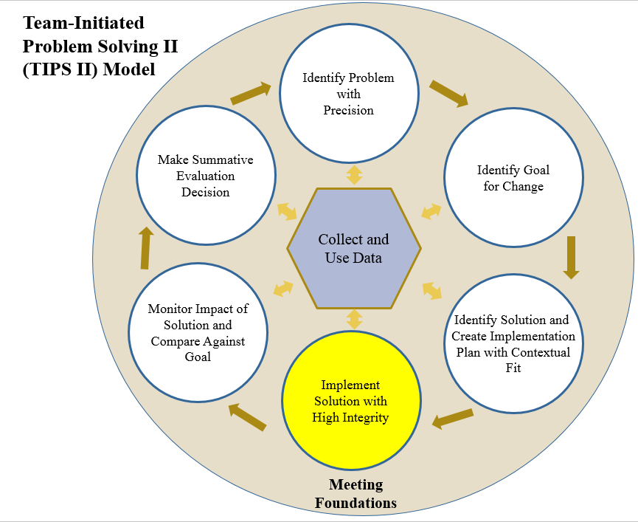
Possible Fidelity Checklists
Establish a fidelity check routine that relates to Implementation
A 1-5 scale is used for questions
Up to 3 questions per week
Share scale as a poster in the faculty room, an electronic survey, or paper and pencil
Did you provide “high-five greetings” to all students entering your class on time in the morning this week?
1 2 3 4 5
No Yes
How many days during the week did you review with students the procedures for passing in the hall?
1 2 3 4 5
✓
✓
✓
✓
✓
✓
✓
Notes:
Fidelity- “did we do what we said we’d do?” Establishes accountability for involved staff persons to perform the team solution. If school-wide (all staff), notice the shared nature of the fidelity questions, incorporating both a public prompt or reminder (seeing it on wall) and public accountability (seeing dots or checks). Sites may also elect for more private fidelity checks by online surveys, paper-pencil, etc.

Slide 45
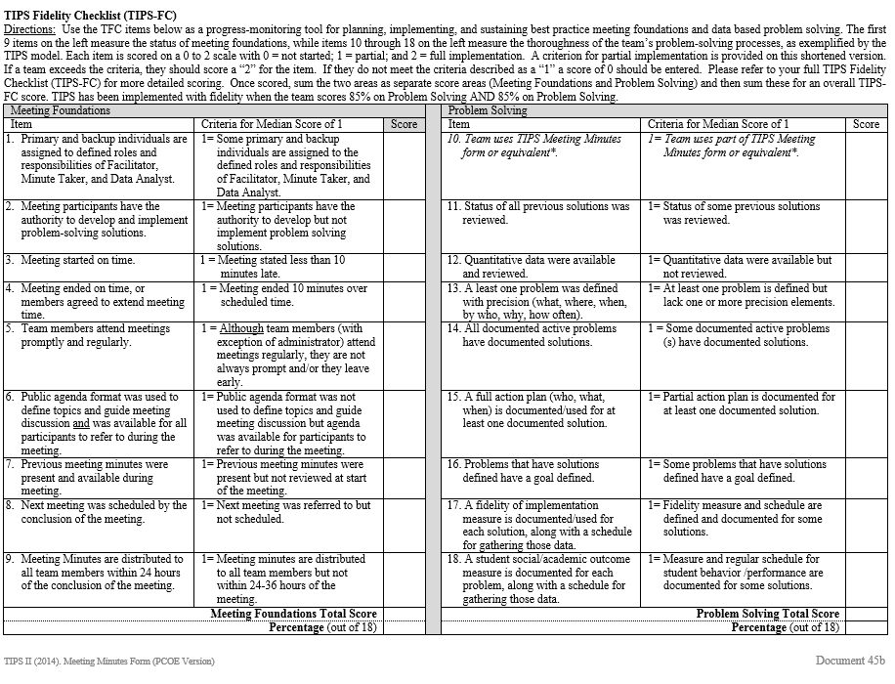
How can we be sure that we are running our TIPS meetings correctly?
Use the TIPS Fidelity Checklist:
Document 45b LAST PAGE
Notes:
TFC- Fidelity of meeting foundations as well as team problem solving. Teams may elect to do this as a means to strengthen team meetings, progress monitoring tool, etc. to make sure effective meetings continue.

Slide 46
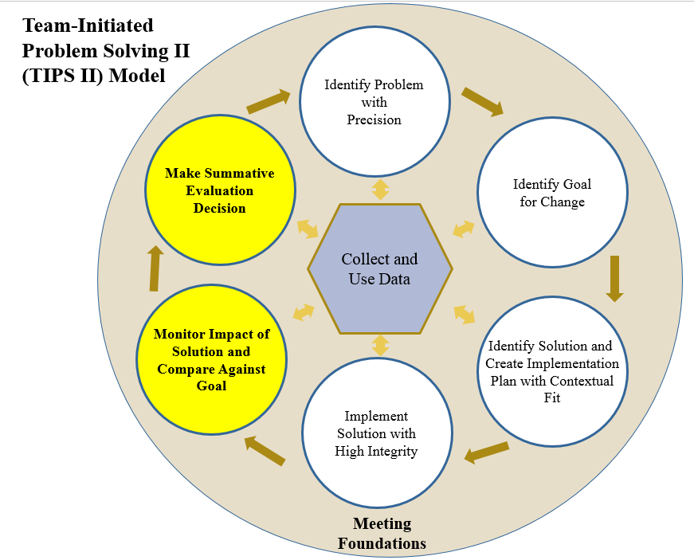
Turn and Talk: Review sample TIPS Form, What decision would you make?
Notes:
Using this example TIPS minute form, draw attention to the green circled areas that point out both fidelity and outcome data. Teams will spend one minute discussing what to do as a result of the data: continue, modify, or stop. If time allows, ask some hypothetical questions if form indicated no, or partial fidelity of solution.

Slide 47
Team Work Time
Guiding question | Team task | Use
How well do you run efficient meetings and make data based decisions? | Go through TIPS Fidelity Checklist as a team. | TIPS Fidelity Checklist Document 45b, last page
Do you run your meetings to fidelity? | Evaluate areas that can be improved and create a list of priorities for improvement. | Action Plan (Document 96)
Notes:
Encourage teams to identify areas that are actionable and can help improve their Tier 1 meetings.
Click once for roster animation and again to remove the roster

Slide 48
Stop, Walk and Talk Expect Respect-- Bully Prevention
Adapted from:
Scott Ross & Rob Horner Utah State University and University of Oregon
Notes:
We will be including Bully Prevention in our Tier 1 training moving forward, but wanted to introduce you to the curriculum and give you some time as teams to figure out a workable way to include school-wide Bully Prevention at your site.

Slide 49
Bully Prevention within PBIS Implementation
School-wide Expectations
-------------------
Define, Teach Acknowledge, Data System, Consequence System
Classroom Systems
Bully Prevention
Notes:
Bully Prevention fits well with the Tier 1 implementation, as it addresses overall school-wide expectations focusing on how we treat others, as well as how to respond in a bullying situation. Combined with school-wide expectations and classroom systems, it provides a comprehensive approach school-wide recognition of bullying behaviors as well as what to do when you are the victim, one who is displaying bullying behavior or a bystander.

Slide 50
The Logic: Why invest in Bully Prevention?
The National School Safety Center (NSSC) called bullying the most enduring and underrated problem in U.S. schools.
(Beale, 2001)
Nearly 30 percent of students have reported being involved in bullying as either a perpetrator or a victim.
(Nansel, et al., 2001; Swearer & Espelage, 2004).
Victims and perpetrators of bullying are more likely to skip and/or drop out of school.
(Berthold & Hoover, 2000; Neary & Joseph, 1994)
Victims and perpetrators of bullying are more likely to suffer from underachievement and sub-potential performance in employment settings.
(Carney & Merrell, 2001; NSSC, 1995).
Notes:
This is research that supports the work of bully prevention.

Slide 51
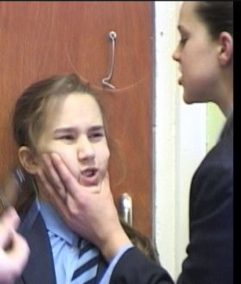
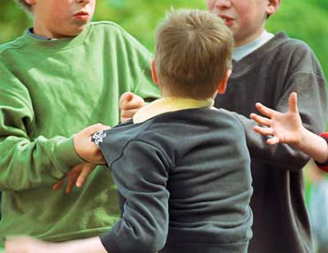
What is Bullying?
“Bullying” is aggression, harassment, threats or intimidation when one person has greater status, control, power than the other.”
Notes:
The term ‘bullying’ is often times overused. This is a definition that you can share with your teams and school staff to help give clarity to the term.

Slide 52
What do you see?
Notes:
These are pictures of potential bullying incidents on a school campus.. Ask for teams to create potential scenarios that fit with the pictures above.

Slide 53
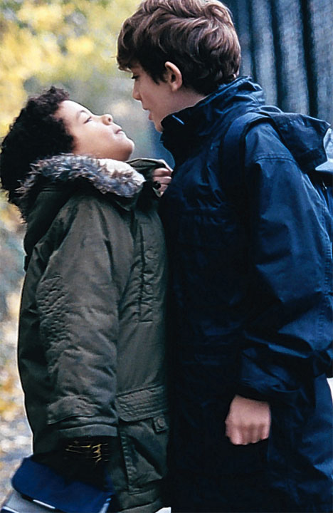
Why invest in School-wide bully prevention?
Most Bully Prevention programs focus on the bully and the victim
Problem #1: Inadvertent “teaching of bullying”
Problem #2: Blame the bully
Problem #3: Ignore role of “bystanders”
Problem #4: Initial effects without sustained impact.
Problem #5: Expensive effort
What do we need?
Bully prevention that “fits” with existing behavior support efforts
Bully PREVENTION, not just remediation
Bully prevention that is sustainable.
Notes:
The curriculum provided on pbis.org fits it well with the Tier 1 expectations and lessons for expected behaviors. It gives the opportunity to teach, role play and reteach, if necessary.

Slide 54
A three part approach to school-wide Bully Prevention
Establish a whole-school social culture where positive behavior is “expected” and rewards for bullying are NOT provided.
Provide training and support for adults to
(a) train, (b) precorrect, and (c) provide
consequences for bullying
Provide direct, individualized support for students who engage in “bullying” or “victim” behaviors.
Notes:
This 3 part approach is directly in line with Tier 1 PBIS implementation.

Slide 55
Bully Prevention Curriculum
Free resources:
http://www.pbis.org/school/bully-prevention
Notes:
This is the link for the free curriculum download. Go to the link and show the curriculum and how to teach it… ;)

Slide 56
Guiding question | Team task | Use
How will you incorporate the Bully Prevention Curriculum into your PBIS lessons? | Develop a plan to include the Bully Prevention lessons with your PBIS expectations lessons. | School Year Calendar/ Action Plan
Notes:
Give teams 10 minutes to work and explain that they will have more time during the allotment of team time later.

Slide 57
PBIS Assessments
Notes:
We use PBIS Assessments as a resource for fidelity measures for our District.
Online support providing fidelity measurements like the TFI, SAS, etc.

Slide 58
Notes:
There are some slides that use current research and best practice to highlight the importance of data.
This table demonstrates the importance of using both fidelity and outcome data in decision making. When schools monitor what they are doing (fidelity) and what effect it is having (outcomes) they are able to move toward success that can be sustained and replicated.
Lucky Quadrant
Schools in the “Lucky Quadrant” have achieved high results before they walk into school in the morning. They are not able to link their professional practices to results because they do not know how their practices influence the outcomes.
Losing Quadrant
Schools in the “Losing Quadrant” have low results and have no idea what to do to improve. They tend to engage in self-defeating behavior by doing the same thing year after year and expecting different results. They rarely study their systems and practices to determine if they are making an impact on students. They tend to blame the poor performance on their situations and circumstances.
Learning Quadrant
Although schools in the “Learning Quadrant” have not yet achieved their desired results, they do possess keen insight into the antecedents of excellence. These educators dig deeply into data to determine effective systems and practices that are helping students to achieve. They look for examples of excellence and work to replicate these successful practices.
Sustaining Quadrant
Schools in the sustaining quadrant enjoy the optimal combination of high results and a keen understanding of the antecedents of excellence. Schools in this quadrant, however, do not rest on their laurels. Rather, they are perpetually seeking opportunities to improve. They continue to implement effective practices as they work with students.

Slide 59
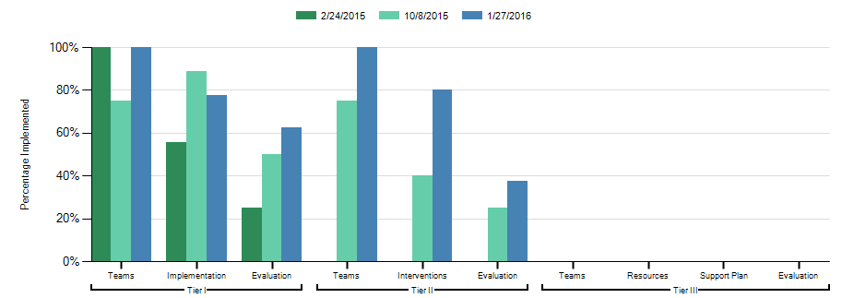
Tiered Fidelity Inventory
Tiered Fidelity Inventory (TFI): An assessment tool developed by the University of Oregon, PBIS Technical Assistance Center
Provides teams with a single, efficient, valid, reliable survey to guide implementation and sustained use of school wide PBIS
www.pbisapps.org
Notes:
The TFI,will be done formally each Spring is the district’s main measurement tool to measure implementation growth. Can be compared with previous years, and breaks down school performance in key areas: teaming, implementation, and evaluation (data). Teams complete this tool across all tiers, and move into “readiness” when they achieve 70% fidelity. Results can assist teams in leading action planning efforts.

Slide 60
Purpose of the TFI
Formative Assessment
Determine current PBIS practices in place
Progress monitoring
Guide implementation efforts, and assess progress by tier
Build action plan to focus implementation efforts
Turn and Talk:
How skilled is your site team at using the assessment for action planning?
Notes:
Relate to academic Formative assessments. Helps team identify a focused area to improve. NOTE: Have teams wait for the turn and talk until next slides are shown.

Slide 61
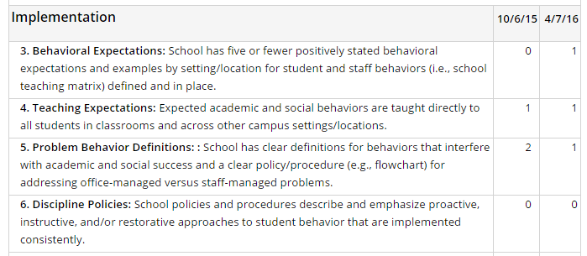
Action Planning
Item 1.4: Team Score =
Notes:
Trainer Notes: team took TFI, examined their scores and 1.4 as a possible next item to work on. They scored themselves a 1 because their system was not formalized.

Slide 62
Action Planning
Item 1.4: Team Score =
1
2
2
1
Complete teaching plan schedule for year using teaching example from PCOE website
Mike
01/01/17
2
Reflection: What would be an appropriate action item for 1.4? Who would be responsible, when will it be completed?
Notes:
Slide progresses w/ fields being filled. At reflection, pause and allow teams to have 1-2 min to chat about possible actions in moving from a “1” to a “2”. You may elect to either have teams look at previous slide, OR, move back to previous slide to see what a “2” in 1.4 would be. Then progress slide to expose answers.

Slide 63
School-Wide Data Collection Timelines
Responsibility | TFI | SAS | POI | SISWEB Data
Annually in the Spring | ✔
Annually in the Fall |  | ✔
One x per year in January/February with your PBIS Coach |  |  | ✔
PBIS Site Team Meeting (Monthly) |  |  |  | ✔
Notes:
District schedule of fidelity measures. Important to know and share with faculty given the amount of initiatives asking teachers for questionnaires or surveys is increasing.

Slide 64
Team Activity & Discussion
Guiding question | Team task | Use
How will your school maintain Tier I while building Tier II systems? | Complete the TFI for Tier I Enter TFI into PBIS Assessments Be prepared to share out with the larger group. | TFI Tier I Section only Document 97 TFI: PBIS Applications pbisapps.org
Remember that your Tier 2 score is a baseline
Notes:
Complete the TFI for Tiers I and II only. Use the items from Tier I as Action Plan items to solidify Tier I. Let the teams know that it will be likely they will have many 0’s in Tier II. That is fine! This is a baseline. We will complete Tiers I and II again after the Day 3 training.

Slide 65
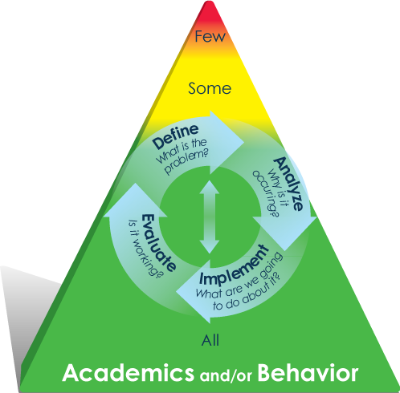
Tier 2 in PBIS
Notes:
Now we will get into the meat of Tier 2.

Slide 66
Continuum of Decision Making
Tertiary — intensive, individualized
1-5% of student population
TIER 3
TIER 2
Secondary — targeted, small group
10-15% of student population
TIER I
Universal — primary prevention
80-90% of student population
Notes:
Review of the triangle and the focus of today’s training:
Our focus is on the decision making using data that helps us meet the needs of the students who need additional support that Tier 1 does not provide
Focus teams on the inside of the pyramid, to the problem solving cycle and how it compares to the TIPS cycle of data-based team problem solving. Again, see the resemblance to how we address both academic AND behavior/social issues.

Slide 67
Continuum of Instructional & Positive
Behavior Support
Intensive Individualized Interventions:
Systems for Students with High-Risk Behavior
TIER 3
Targeted Group Interventions:
Specialized Group
Systems for Students with At-Risk Behavior
TIER 2
TIER I
School-/Classroom-
Wide Interventions:
All Students,
Staff, & Settings
Notes:
Review the focus of each tier that includes the instructional as well as behavioral support.
Slide emphasizes tier 2 for Targeted Interventions. Take a moment to create a profile of students who might fit into this tier; opposed to students that might require more/less supports; “high flyers” vs. “on our radar”.

Slide 68
PBIS: Multi-Tiered System of Supports
TIER 3
Prevent Teach Reinforce (PTR)
Behavior Support Plans
Mental Health Services
TIER 2
Check In Check Out, Steps to Respect, Mental Health First Aid, Signs of Suicide
TIER I
Bully Prevention
Eliminating Barriers to Learning
PBIS Key Features
Notes:
This chart shows the system of the basic supports for interventions at each level.
Map indicating where each support system/intervention falls. Sites may discuss if one “belongs” into one or more tiers. Possible discussion on “severity or intensity” of the intervention or mode of instruction ie, whole class (tier 1) or small group (tier 2).

Slide 69
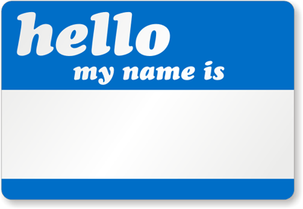
Label behavior…not people
Students themselves do not fit into a tier of supports.
Is the student successful at this level of support? Improved student outcomes are the result of continually monitoring and modifying.
Writing
Reading
Social-Emotional/
Behavior
A Student in need of Tier 3 Support
A “Tier 3” Kid
Math
Notes:
Trainer Note: We continue to stress person first language in all of our trainings. We refer to students that need Tier II or Tier III interventions, not Tier II or III students or “green, yellow” or red” students.
Within a multi-tiered system of prevention and support, a student can receive differing levels of support depending upon skill strengths and weaknesses. The triangle represents a continuum of decision making and support.
Consider having teams think of students (or themselves as students) and where they might have needed additional supports in their school day.

Slide 70
Students have complex needs…
Notes:
As part of our Tier 1 and Tier 2 systems, we look at how we are meeting the needs of ALL of our students… Often times, the students present differently,, so it’s not just the students who have disruptive behavior. Sometimes, it’s the quiet or isolated student who needs some Tier 2 interventions.
Consider the quote: “At any point in the day, at least one student in your class is either having a problem, getting over a problem, or will experience a problem”. Alert teams that many of the behaviors they see as challenging may have originated from something completely outside the classroom or school day.

Slide 71
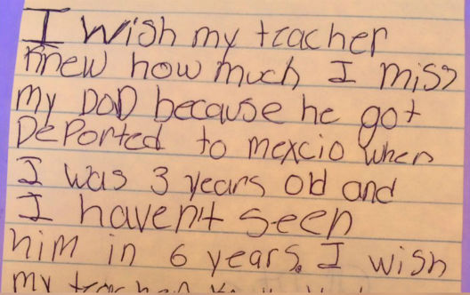
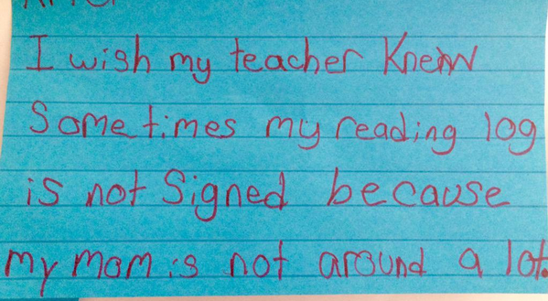
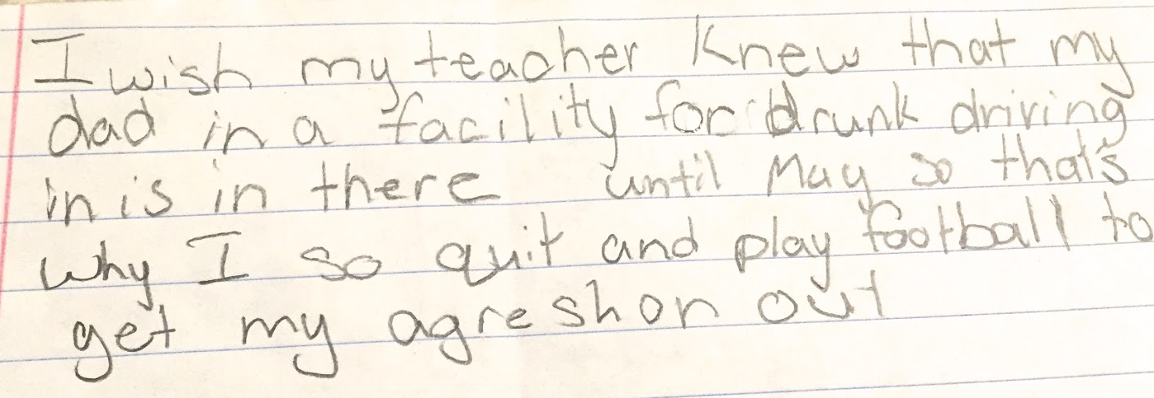
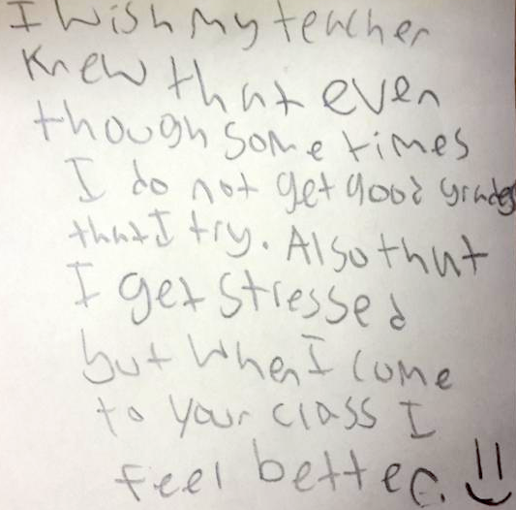
“I Wish My Teacher Knew”…
Notes:
Examples of issues impacting student’s academic success that we might not know about. Possible exercise to establish trust and positive rapport with hesitant students who do not approach adults well or often.
This is an example of a great activity that we can do to really hear the student voice of what matters to them and what is often going on in their lives, that we aren’t aware of, unless we take time to ask them.

Slide 72
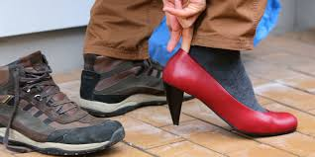
Empathy
Notes:
Show this video and then give time for teams to discuss if empathy exists at their school. Is it something that can be improved among students/ staff? Is it already a strength at their site?

Slide 73
Guiding question | Team task | Use
Who are some of your students that you think of that might benefit from Tier 2 Interventions? | Work together to identify some of your students in need of Tier 2 Interventions. | Anecdotal data Synergy reports (if available)
Notes:
Give teams 10 minutes to discuss students of concern. Highlight the need to discuss with the team students that may need additional supports and the importance of identifying them early in the year. If Synergy reports are available, encourage them to use data to help drive their decisions.

Slide 74
Critical Features of Tier 2 Interventions

Slide 75
Tier 2 Behavior Support Interventions Provide:
Increased structure and prompts
Instruction on skills
Increased regular feedback
Intervention is available to anyone at any time
Think of an example
TFI 2.6
Horner & Todd, 2002
Notes:
The components are essential in Tier II interventions – discuss one at a time – give examples.
Increased structure & prompts: The student is given more frequent reminders and has more structure in the school day. (CICO)
Instruction on skills: Students are taught essential social skills that are needed: Social Skills group, Recess club, Anger Management, etc.
Increased regular feedback: Student is provided positive feedback and corrections more frequently through the day, keeping with the 5:1 goal
Intervention available: Tier II interventions need to be available to identified students quickly and easily.

Slide 76
Strong Tier 2 Intervention Systems:
Tier I PBIS is in place
Problem-solving focused Intervention Team
Consistent with school expectations
Rapid access to intervention
Very low effort by teachers
Screening to identify students needing supports
Data-based progress monitoring & decisions
Uses efficient, available evidence based practices
Notes:
Tier 2 interventions are most effective when the systems are in place.

Slide 77
Intervention Teaming: Targeted PBIS

Slide 78
Multi-Tiered System of Supports in Schools
Conduct assessments
Develop plan
Student Centered Team
Monitors effectiveness and fidelity of Tier II-III Interventions
Intervention Team
Plans school and classroom supports
PBIS Team
Notes:
In Tier II training, we focus on the development of the Intervention Team. This is a team that progress monitors students and the effectiveness of the Tier II-III interventions. This team is also a very active intervention team to help problem-solve and make sure that students needing additional support are given opportunities to be involved in interventions that meet the need of the function of their behavior.

Slide 79
Teams in Schools
Tier 3: Student Centered Team
Meets at least twice a month; more if needed
Creates an individualized plan
Determines interventions
Analyzes data & makes decisions about when to implement or modify an intervention
Tier 2-3: Intervention Team
Meets every 2-4 weeks
Coordinates & monitors Tier 2 behavioral interventions
Analyzes data & recommends changes in interventions
Tier I: PBIS Team
Meets monthly to sustain universal system for ALL students
Notes:
This chart quickly summarizes the three teams on site that

Slide 80
Intervention Team Operating Procedure

Slide 81
Tier 2 and 3 PBIS
Efficient Teaming Process
Clear roles, procedures & responsibilities
Intervention Focused
Linked to Continuum of Interventions
Try Tier II Interventions first! …then, if needed: Tier III
Data Focused & Early Identification
Progress monitoring
Student identification through systematic screening

Slide 82
"Old Model" vs. Intervention Team
"Old Model":
Test/Label/Place
INTERVENTION TEAM: Evaluate/Problem Solve/Intervene
Notes:
Education has changed in how students are assessed and provided supports. With the advent of RTI, we focus on meeting the students where they are, and providing needed supports. Not just test-label-place if you qualify.

Slide 83
"Old Model" v. Intervention Team
"Old Model":
Focus on only special education
INTERVENTION TEAM: Services for all students (including SPED students)
Notes:
Services are provided for students that need supports; not just students qualifying for special education.

Slide 84
"Old Model" vs. Intervention Team
"Old Model": Primary focus spending entire meeting on one student
INTERVENTION TEAM: Teacher input gathered ahead of time; meetings serve a coordinating & monitoring function
Notes:
The Intervention Team meeting is used for progress monitoring all students on Tier II-III interventions; focusing on data. Data is acquired before the meeting, students needing modifications are the focus of the meeting. If one student needs a more intensive planning meeting, that meeting is scheduled outside the Intervention Team meeting.

Slide 85
Intervention Team Composition: (See back side of Document 101)
Intervention Team Lead
Coordinator(s) of Tier II Interventions
Coordinator of Tier III Interventions
Minute Taker
Site Administrator
PBIS Team Lead
Notes:
Refer the participants to Document 101 as they consider the Intervention Team membership.

Slide 86
Intervention Team Meeting Procedures
Team meets 1-2 times per month
Team processes Requests for Assistance Forms and examines screening data
Team uses meeting agenda format:
Document 45b: binder/packet
Team monitors progress of students receiving Tier 2/3 supports

Slide 87
How does this look at various sites?
We have a PBIS Tier I Team. Our Tier 2 & 3 Team is different, with two members on both teams
Our PBIS Team meets monthly, and our Tier 2-3 Team meets every other week
We are a small school. Our Tier I, Tier 2 & 3 teams are the same people
We have three separate teams: a Tier I Team, a Tier 2-3Team and an Individual Team for Tier 3
Our PBIS Team meets every other week; Our Tier 2-3 team meets every Friday
We meet every week for 30-45 minutes for all Tiers
Notes:
After sharing this slide, talk about the importance of the teams to fit the needs/culture of the school site.

Slide 88
3-Tiered System of Support Communication
Universal Team
Intervention Team
Uses Process data;
Determines Overall Intervention Effectiveness
Recommends Interventions
Plans School-Wide Supports
Using TIPS Process
Example: The School Counselor serves on both teams:
She will provide Tier I updates at the Intervention Team Meeting
She will provide Intervention Team updates at the Tier I Team Meeting
CICO
Student Centered Teams
Modified CICO
Staff Implement and Give Feedback on Tier I System
Each Targeted Intervention has Assigned Coordinator Each Determines Student Response
Targeted Social Emo. Group
(Strong Kids)
PTR
WRAP
Each Student Centered Team has Assigned Coordinator Each Determines Student Response
Other Targeted Interventions
Notes:
88
88

Slide 89
When will we see you again?
FUTURE TIER 2 TRAINING DATES…
Q: Who attends future Tier 2 Training dates?
A: Your Tier 2 Intervention Team
Q: What happens to the Tier I School Wide Team?
A: They keep meeting and sustaining Tier I

Slide 90
Team Work Time
Guiding question | Team task | Use
Do you have an existing team focused on identifying & monitoring students needing Tier 2 supports? | Identify existing team(s) at your school that could be the Intervention Team | Staff Handbook or Site Organizational Chart
How will you develop your Intervention Team? | Identify Team members (Roles will be determined on Day 2) | Team Roster: Document 102
How will your Tier I and Intervention Team maintain Communication? | Identify Communication Plan for Site PBIS Teams | Action Plan Document 108
Notes:
Provide team time for the remainder of the training day. Leave 10 minutes at the end to do evaluations.

Slide 91
Overview of Tier II PBIS Training
Date | Content
Day 1 | Solidify Tier I Practices (TFI Score of 70% or More) TIPS Update Bully Prevention Intervention Team Established Communication System for Tier I and Tier 2Teams
Day 2 | Intervention Team Roles/Template Identifying Students for Tier 2 Identifying Community Supports Check in Check Out Roles Identified
Day 3 | Check In Check Out Process Check in Check Out Communication System
Day 4 | Assess fidelity and outcomes in CICO Decision Rules Established Targeted Intervention Guide
Notes:
This provides an overview for the training for the year.

Slide 92
Questions, Comments and Evaluations

Slide 93
Thank you!
Contact information:
PBIS Coaches & Behavior Support Specialists
Elk Grove Unified School District PBIS Website
http://blogs.egusd.net/pbis/
Notes:
Explain that they can find their contact through the website coaches section.

